Slide 1
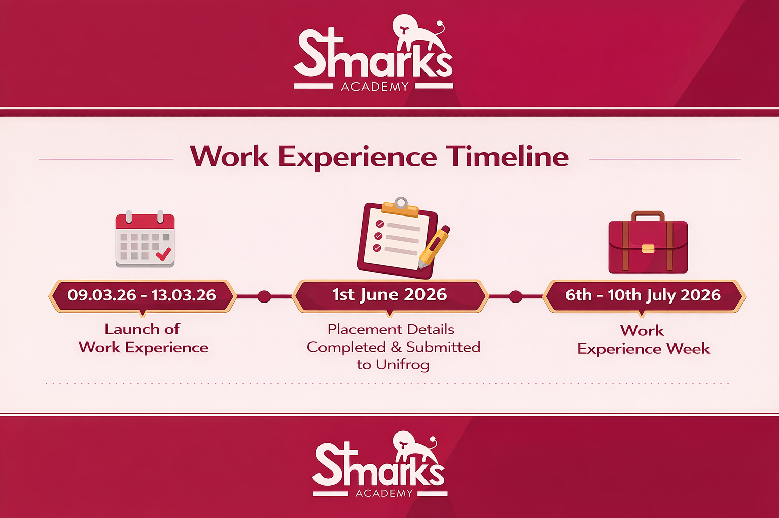

Slide 2
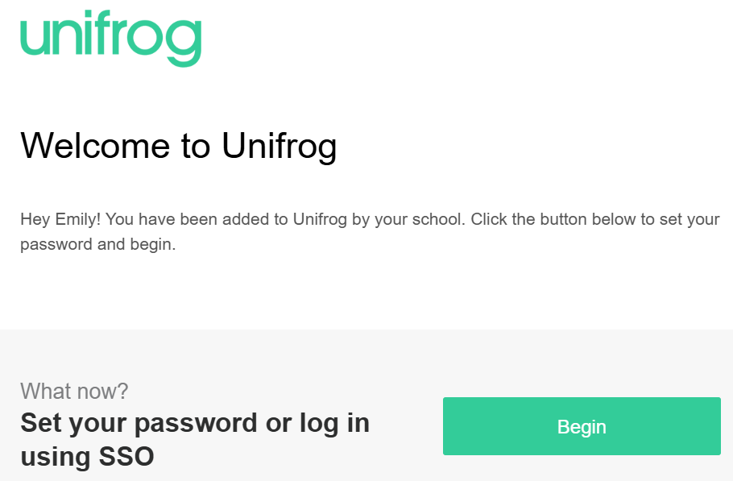
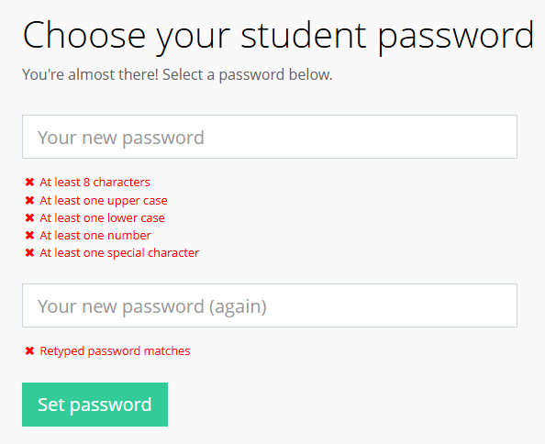

Logging into Unifrog for the first time: Welcome email
An email has been sent to your school or college email address (check your junk/spam folders).
Click ‘Begin’ and follow the instructions. Create a memorable password and make a note of it!
Notes:
Teacher’s notes:
If your school/college is using welcome email method to set up their own passwords, deliver slides 8-21.
If your school/college has single sign-on (SSO) set up, students will be able to log in straight away via Google or Microsoft accounts. Deliver slides 23-36.
If your school/college is using the temporary password method, deliver slides 38-51.
Creating a password:
Encourage students to make a note of their Unifrog password.

Slide 3







What is work experience?
    What do you already know about work experience?
Use the questions below to get you started…
What kind of places could you complete work experience in?
What kind of things might you do during work experience?
What skills could you develop on work experience?
What might you learn from your work experience?
What else might you get out of doing work experience?
How do you find somewhere to do work experience?
Notes:
Teacher’s notes:
Encourage students to come up with their own ideas of what work experience is and why it’s important. If you’re giving this presentation in an assembly, students could discuss with those sitting around them first.

Slide 4
What is work experience?
What kind of places could you complete work experience in?
What kind of things might you do during work experience?
You can work anywhere! As long as they’re happy to have you and have insurance.
You might shadow, help on projects, support other staff, or something else!
Your confidence, independence, teamwork, social, and listening skills.
What that job is really like, expectations at work, and more!
What skills could you develop on work experience?
What might you learn from your work experience?
You might find you dream career! Or, you might learn what you wouldn’t like to do.
What else might you get out of doing work experience?
How do you find somewhere to do work experience?
It’s your job to find a placement, but we’re going to look at how to do this.
Notes:
Teacher’s notes:
Each question is animated to disappear and reveal suggested answers beneath.

Slide 5
Miss Unifrog’s Year 10 work experience
Miss Unifrog did work experience in a department store.
How I found a place:
I took my CV to stores in the shopping centre and handed it in. Then I followed up by email asking for a placement.
What I did:
I worked one day in each department. I helped out staff and customers on the shop floor. I also did a project where I wrote a radio advert for the shop.
What I got out of it:
Experience for my CV and interviews
A better idea of retail and sales
Confidence
Independence
A project for my portfolio
Notes:
Teacher’s notes:
This is Unifrog’s example of a teacher’s experience of work experience when they were at school. You have two slides where your teachers can share their own experiences. You can add more examples by duplicating the slide.

Slide 6
How do you find work experience?
We can support you, but it’s your responsibility to find a placement!
Talk to local businesses
(e.g. shops, hair salons)
Talk to local services (e.g. the library, the council office, museums, etc.)
Talk to friends and family who have businesses
Talk to the clubs you belong to outside of school (e.g. Scouts, sports teams, etc.)
Talk to local nurseries and primary schools
Talk to the local branch of a chain company
Notes:
Teacher’s notes:
Add in relevant examples where the red text is.
Some placements need to have Employer’s Liability Insurance. Please stress this to students.

Slide 7




How do you organise work experience?
This is a four-step process using Unifrog’s Placements tool:
Step 1
Contact employers via email or letter.
Step 2
Once you’ve got a place, complete the Placement form on Unifrog.
Step 3
Your employer and parents/caregivers will confirm the placement via email.
Step 4
We approve your placement so you can get started.
Notes:
Teacher’s notes:
You can use this video for a full walkthrough of how students add a placement to the Placements tool: https://cdn.unifrog.org/video/u6p771n5f6/720.mp4
We’ve shared this link again on slide 12.

Slide 8

Step 1: contact employers via email or letter
Even if you know the employer personally, you should contact them in writing, using formal language.
You need to include:
The date of your work experience: 6th-10th July
Why you would like to complete your work experience at this organisation
What you can offer them
Top tip:
Get someone to proofread your letter/email to help check for typos or any errors.
Why do this?
This will help you practise writing real job applications. It also sets a professional tone for your placement.
Notes:
Teacher’s notes:

Slide 9
Work Experience (6–10 July)
You need to start looking for your work experience placement for 6–10 July.
Use this guide to help you: https://www.unifrog.org/student/know-how/direct/for-students-a-guide-to-finding-and-completing-work-placements
Steps:
Think about the type of job or career area you are interested in.
Look for local businesses or organisations in that area.
Email or speak to employers to ask if they can offer you a placement.
Use the email template provided to contact them.
Once you have found a placement, you will need to record it on Unifrog.
If you have any questions, please speak to Miss Bowen, Assistant Principal Ebowen@stmarks.anthemtrust.uk

Slide 10
Dear [Name / Company],
My name is [Student Name] and I am a student at St Mark’s Academy.
From 6–10 July, all students are completing a week of work experience. I am currently looking for a placement and was wondering if you would be able to offer me the opportunity to spend this week with your organisation.
I am interested in working in [type of job / industry] and would really like to learn more about the work you do.
If you need any more information, please contact Miss Bowen, Assistant Principal Ebowen@stmarks.anthemtrust.uk
Thank you for considering my request.
Kind regards,
[Student Name]
[Year Group]
St Mark’s Academy

Slide 11
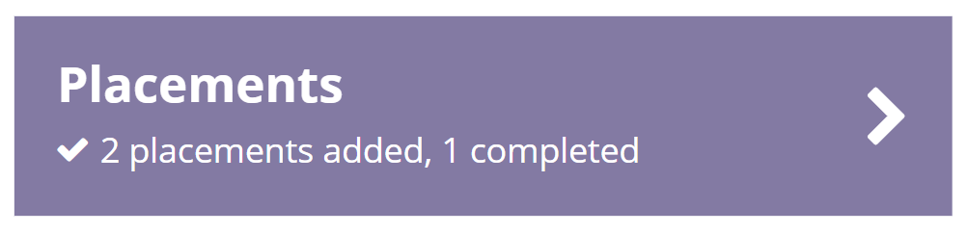
Step 2: complete the Placement form on Unifrog
Once an employer accepts your application, log onto Unifrog and complete the Student initial form on the Placements tool.
You can find the Placements tool under the ‘Recording’ section of tools.
What if you don’t get offered a place?
Don’t panic! Keep applying, and try out new employers. If an employer isn’t replying to you, try giving them a polite phone call.
If you need help, please ask your teachers.
The most popular placements get taken up first, so don’t hang around! Get started ASAP.
Notes:
Teacher’s notes:

Slide 12

How do you fill in the Placement form?
On the Placements tool, click ‘Add new placement’ to access the 'Student initial form'
Confirm that you’ve agreed your placement with your employer, and fill in the details
  Your Placement start and end dates must be 6th-10th July
  Your Placement coordinator is Miss Bowen
If any part of your placement is in-person, select ‘Yes, it’s all part or in-person’
Complete the rest of the form and double-check every detail!
This video will show you how to complete your form
Notes:
Teacher’s notes:
The video is six-minutes long. The link is also here: https://cdn.unifrog.org/video/u6p771n5f6/720.mp4

Slide 13
Step 3: get the placement confirmed
The employer will automatically get an email asking them to complete an online form.
Your parent/caregiver will also receive an email for them to agree to your placement.
The emails will be from Unifrog who use the email address: noreply@unifrog.org.
Top tip:
If your employer or parent/caregiver hasn’t got the email, get them to check their junk/spam folder.
If they’re still having trouble, they should get in touch with MISS BOWEN who will be able to help.
Notes:
Teacher’s notes:

Slide 14
Step 4: get the placement approved
Miss Bowen/Miss Burton will look over your placement and make sure everything is good to go.
Once they’ve approved your placement, Unifrog will send a confirmation email to you, your employer, your parent/caregiver, and Miss Bowen/Miss Burton.
Top tip:
You can prepare for your work experience using Unifrog’s Know-how library.
Type ‘professional’ in the search bar to find helpful guides. Start with ‘Professionalism: how to be work-ready’.
These will help you feel confident for your first day!
Notes:
Teacher’s notes:
You can share guides on the Know-how library by clicking the ‘Share’ button and typing in the relevant year group or students’ names.

Slide 15


Here’s what you need to do after this session:
Log into Unifrog and type ‘work experience’ in the search bar to learn more about what to expect, and to get useful tips on applying.
Favourite guides you find so you can come back to them later.
Start looking for placements. You can use [place where the school keeps placement database] as well as online searches.
Remember to talk to teachers, friends, and family for contacts too.
Get in touch with employers you want to work for. You can contact more than one at the same time.
You must have your placement booked by 1st June.
Notes:
Teacher’s notes:
These appear one-by-one so you can talk through each one.
You can visit www.unifrog.org/placement/guides for a detailed look at everything you need to know for placements to go well. We’ve also included this link on slide 17/18.

Slide 16



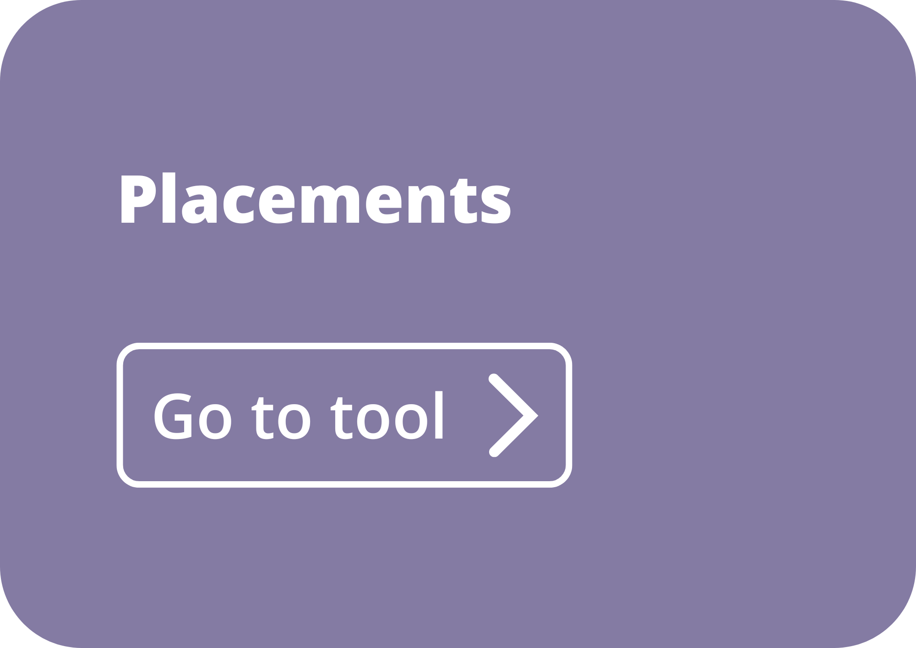

Key information
Work experience will be on these dates: 6-10th July
You must have sorted your placement by 1st June.
You must agree your placement with the employer using the Placements tool on Unifrog.
It’s your responsibility to find a placement. We can support you, but we can’t do it for you.
Notes:
Teacher’s notes:

