Slide 1



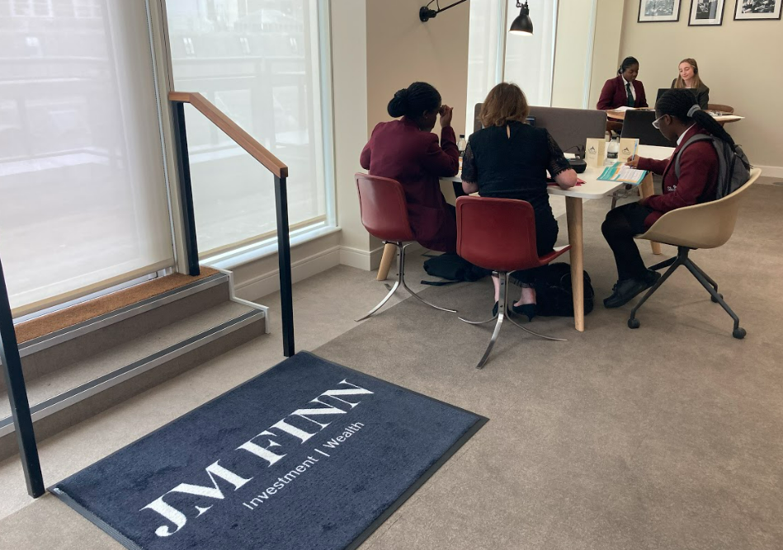

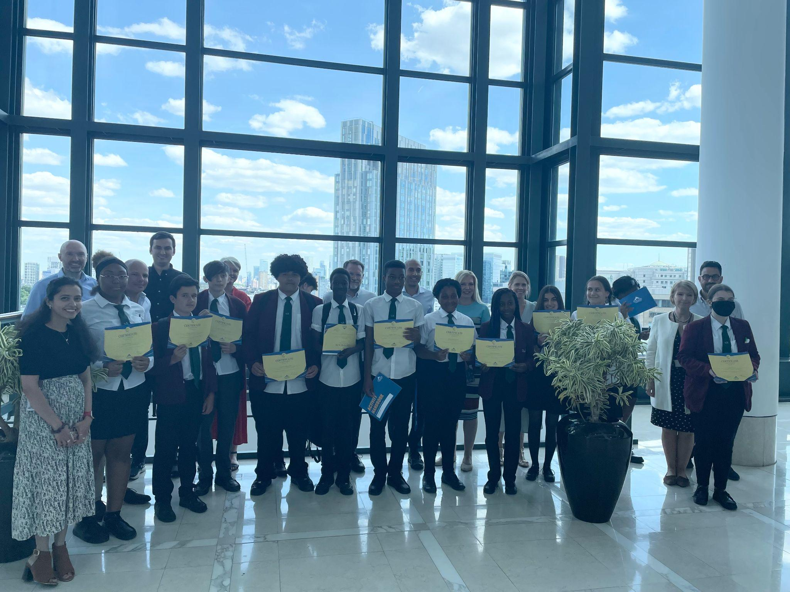
St. Mark’s Academy
Future Frontiers Programme Impact Report
Summer 2022

Slide 2

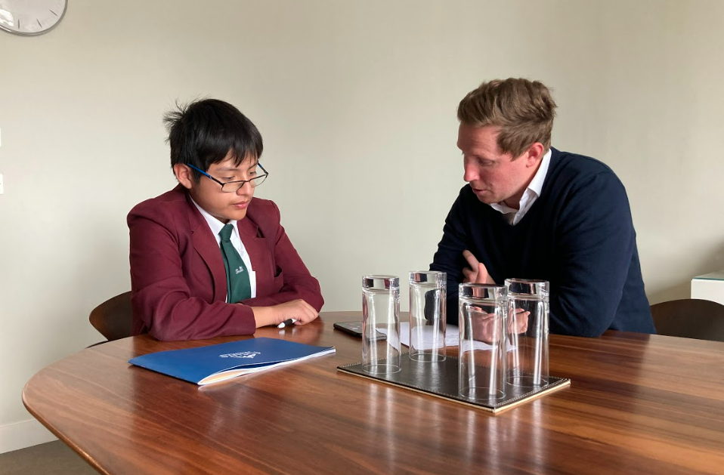
Introduction and impact summary
We are pleased to present an overview of the work students from St. Mark’s Academy completed on the Future Frontiers programme in Summer 2022, and the progress they have made. This report includes a description of the activities pupils completed and the data showing the impact of the Future Frontiers programme on both pupils’ motivation at school and also their career and transition readiness.
About Future Frontiers
Future Frontiers supports young people from disadvantaged backgrounds to realise their potential at school and achieve post-16 qualifications that lead to secure and fulfilling future employment. We do this through an intensive two-year programme of coaching, access to professionals and 1:1 career guidance.
Future Frontiers Year 10 programme at St. Mark’s Academy
In Summer Half Term 2, 38 Year 10 students were supported for 6 hours of tailored coaching. During this period, coaches from JM Finn and Marex provided young people with a space to explore their interests, discover inspiring careers and plan for their next steps. Students also attended a Pathways Seminar in school to build their knowledge and understanding of post-16 options.
St. Mark’s Academy Impact Highlights
38
Pupils
of which 33 were eligible for Pupil Premium
96%
are more motivated to work hard at school
75%
Pupils improved their Career Readiness score
“If I could pass a message to my coach, it would be to thank them for helping me find out what I’m interested in, and helping me choose my career.”
Victor, Future Chemist

Slide 3
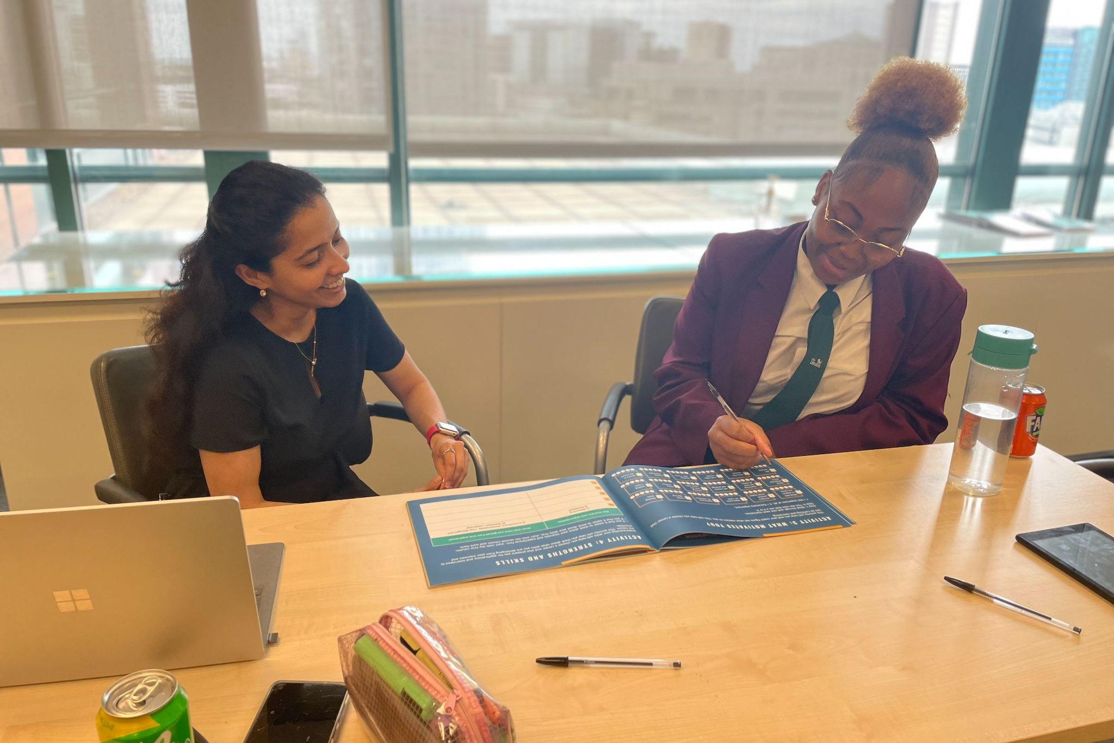
Meeting the Gatsby Benchmarks
The Future Frontiers programme supports schools’ wider careers programme and meets four out of eight Gatsby Benchmarks.
LEARNING FROM CAREER AND LABOUR MARKETS
Pupils explored a range of career paths using specialised online tools that contain accessible and up to date labour market information. They have received support from a trained volunteer through the business coaching to make best use of available career and pathway information.
BENCHMARK
TWO
BENCHMARK
ADDRESSING THE NEEDS OF EACH PUPIL
The programme is highly personalised and provides each pupil with a unique experience that builds a career journey around their individual interests and values.
THREE
BENCHMARK
ENCOUNTERS WITH EMPLOYERS AND EMPLOYEES
All pupils have at least two meaningful interactions with employers during our programme through a combination of coaching sessions and video calls with professionals.
FIVE
BENCHMARK
EXPERIENCES OF WORKPLACES
All four coaching sessions were hosted in the offices of a leading London business and all students benefited from experiencing first-hand, an inspiring workplace setting.
SIX
“Thanks to Future Frontiers and my coach, I now feel much clearer about my future goals and what I want to do when I am older”
Amina
Future Graphic Designer

Slide 4
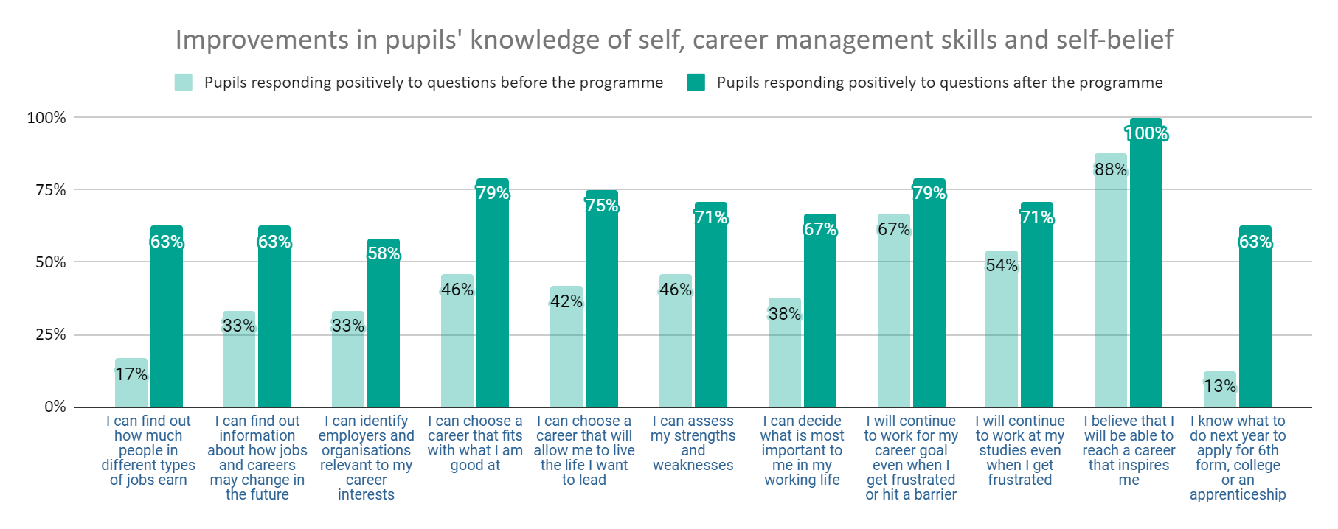
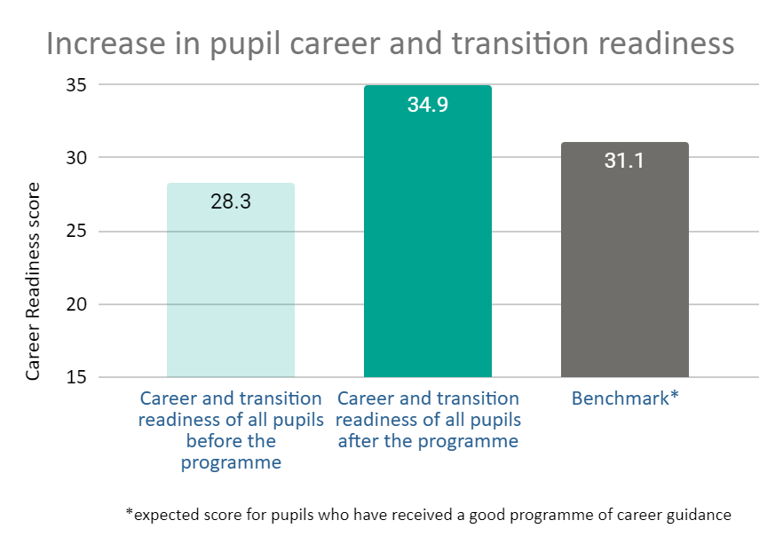
Impact
The following statistics relate to our programme outcomes. The statistics show the percentage of St. Mark’s Academy pupils who responded ‘agree’ or ‘strongly agree' to the corresponding statements before and after the programme.
The above graph shows the impact of the programme on St. Mark’s Academy’s pupils’ outcomes within our theory of change. St. Mark’s Academy Pupils rated how strongly they agreed with statements about their knowledge, skills and belief in the context of their readiness to make positive next steps towards a future career. The statistics show the percentage of pupils who responded positively to these questions before and after the programme.
This graph shows the impact of the programme on St. Mark’s Academy pupils' career readiness. It shows the average of pupils' combined career readiness score before and after the programme. This score has been calculated using questions from the Student Career Readiness Index (SCRI), a validated national scale.
For comparison, the benchmark score is displayed as it represents the average score for pupils in UK schools where a programme of careers guidance has been implemented. This data shows that, following the Future Frontiers Programme, St. Mark’s Academy pupils significantly improved their career readiness and are now performing well above national averages..
100%
of young people agree their coach helped them find an inspirational career
92%
of young people agree that they are clearer on what they need to do to achieve their ambitions

