Slide 1
Underlined : titles of schemes of work
Justice and Equality
Year 8
In the Value of Creation we explore the big idea of Justice and Equality through the lens of climate justice. Students consider how the actions of developed countries contribute to climate change. While it is those who live in developing countries that suffer the most from the effects of climate change. We explore the biblical premise of the Preferential Option of the poor and consider whether the work of charities such as Christian Aid and CAFOD are the best way to support the needs of the poor.
In Moral Decision Making students explore the big idea of justice and equality through the lens of ethics. Students are introduced to the Ethical Principle of utilitarianism, most able students will be able to evaluate that although Utilitarianism is a democratic system it can also be unjust as it could result in the intense misery for the few. Next, students are introduced to Immanuel Kant’s Categorical Imperative in which students understand the importance of upholding objective moral truth in order to create and maintain a just and equal society. Finally, students learn about virtue ethics in particular the cultivation of virtue over vice and how vicious character traits creates unjust behaviour which results in further inequality.
Year 9
In the Kingdom of God students explore the big idea of Justice and Equality by considering in detail Jesus’ care for the outcaste we explore key parables that uphold the kingdom values of justice, peace and reconciliation.
In Evil and Responsibility we explore the big idea of Justice and Equality through the lens of crime and punishment we consider the extent to which individuals have free will and can be considered morally responsible for their actions or are individuals predetermined and cannot be held to account. We question how the killers of James Bulger should be punished and what this suggests about the criminal justice system at large.
The topic ‘What is a Religion?’ facilitates the study of Justice and Equality as students research Ninian Smart’s 7 dimensions of religion the fifth of these is ‘ Ethical and legal’ whereby students understand all religions have rules about how to behave that suggest an objective moral truth, to go against such ethical principles brings about injustice and results in further inequality.
Year 10
In Islamic Practices students focus on the big idea of Justice and Equality through the Pillar of Zakah, Muslims are obliged to donate money to charities such as Muslim Aid and Islamic Relief in order to ensure social justice. We also explore the idea of the lesser jihad and the correct and morally just reasons to wage a holy war.
In Christian Practices ( 2) students focus on the big idea of Justice and Equality, firstly, students explore the Christian belief in reconciliation and learn about organisations such as the Community of the Cross of Nails and how they work towards reconciliation within the communities that they serve. Secondly, students consider the work of Christians within the local community through the work of food banks and street pastors. Finally, we explore how Christians work to tackle poverty on an international level, with a particular focus in the teachings of Jesus in the parable of the Sheep and the Goats with its emphasis on divine justice.
Year 11
In Theme A: Relationships and Families students consider the big idea of Justice an Equality when learning about gender discrimination.. Genesis 1:28 suggests that all humans are made in the image and likeness of God. This informs the Catholic teaching that Gender roles are equal but different students are invited to challenge this assumption especially with regards to the gender pay gap.
In Theme B: Religion and Life students consider Justice and Equality through the lens of the sanctity of human life. Students are invited to challenged this assumption by considering whether the following issues are the lesser of the two evils: abortion, euthanasia and animal experimentations.
In Theme E: Crime and Punishment students explore the big idea of Justice and Equality Students contemplate that although the criminal justice system will aim to bring about justice that both Christians and Muslims alike believe that the ultimate justice is divine justice.

Slide 2
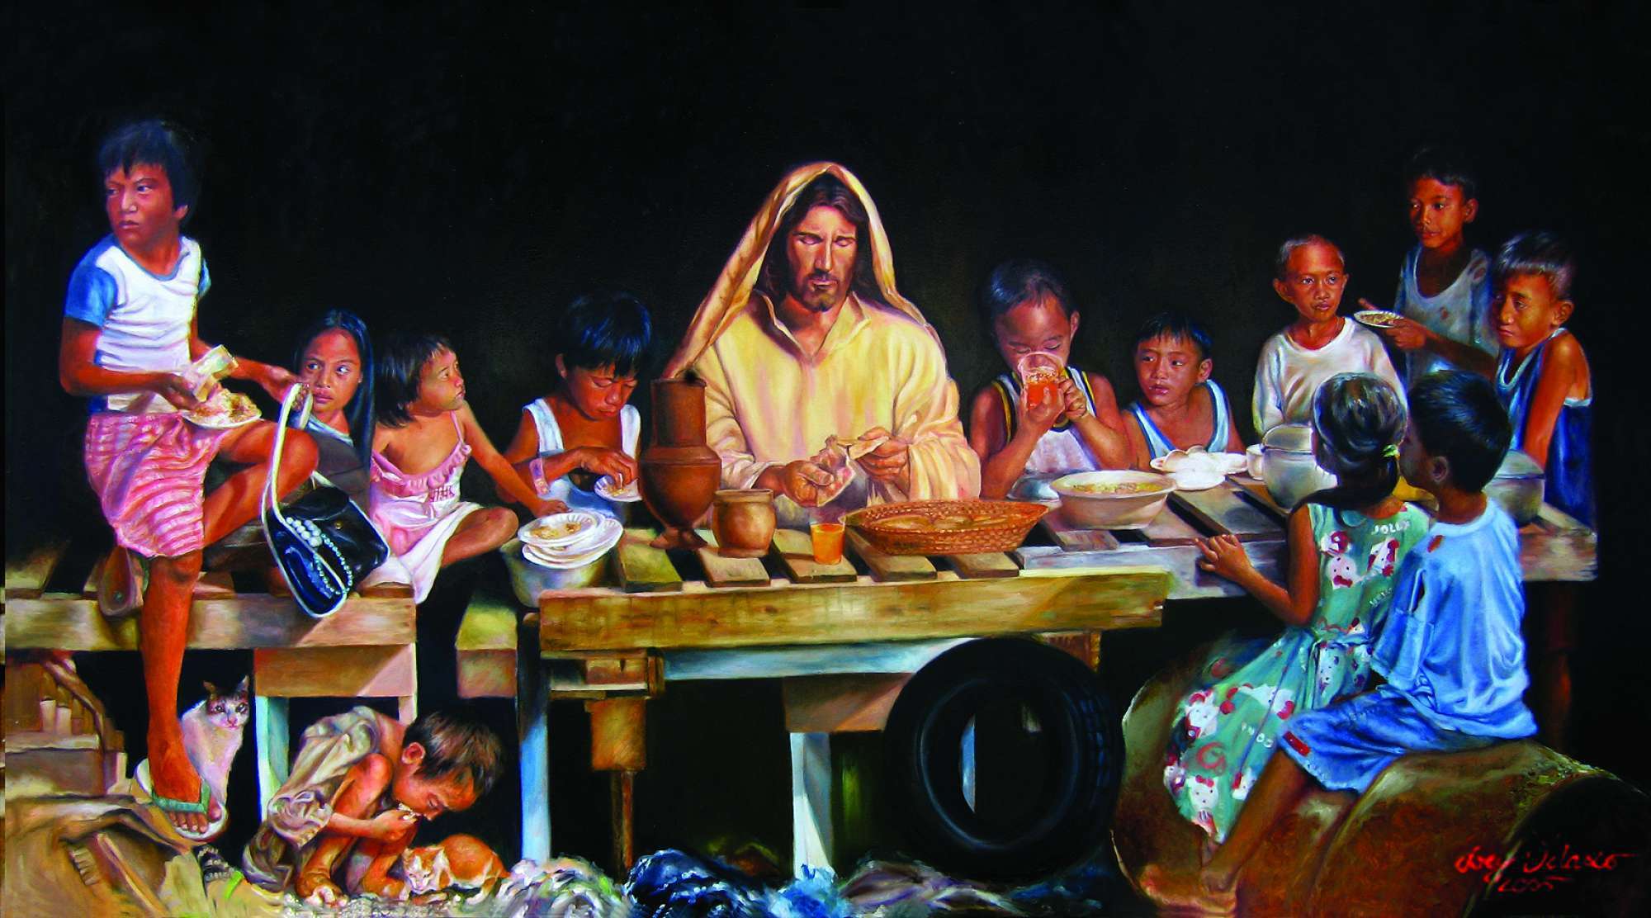
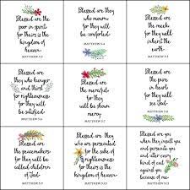
An example of how the concept of The preferential option for the poor is build upon throughout Student’s time at St Marks.
Year 9
In the Kingdom of God in Spring A students revisit the concept of the preferential option of the poor and build upon it by exploring Jesus’ teachings on ‘ The Upside Down Kingdom’ and gather evidence to support the premise that the poor should be given preference when it comes to providing help and support. Students begin to evaluate the concept of the preferential option of the poor especially as Jesus does not explicitly mention the poor in the Beatitudes ( Matthew 5) : instead Jesus describes the following people as blessed: ‘ the poor in spirit’, those who are being ‘persecuted, those who ‘mourn’.
Year 10
In the study of Christian Practices ( 2) in Summer B we revisit the concept of the preferential option of the poor when considering the work of Christians within the local community and how they give alms to those in need further to this students are also required to know how Christian respond to worldwide poverty. With this iteration students are expected to evaluate the concept of the preferential option of the poor: most able students would make reference to Mark 14 whereby Jesus says: ‘ you will always have the poor, but you will not always have me.’ This could be used to justify expenditure on other things such as golden church decorations or even be use to suggest that there is no need to tackle poverty as it will always be a reality of existence. To facilitate this evaluation students study the Utilitarian Philosopher Peter Singer’ thought experiment entitled ‘The drowning child scenario’ to critically analyse whether those living in wealthier countries have a moral duty to support the world’s poor.
A Level
Development in Christian Thought
Year 8
When studying The Value of Creation in Autumn B. Students consider the concept of stewardship and climate justice. We explore the biblical premise of the Preferential Option of the poor which refers to a trend throughout the Bible, of preference being given to the well-being of the poor and powerless of society in the teachings and commands of God.

