Slide 1
Underlined : titles of schemes of work
God’s Love of Humanity
Year 7
In School Values Love Hope and Trust students learn the term agape and the expectation that Christians are expected to replicate God’s love for humanity.
The Person of Jesus students gain an understanding of God’s love of humanity through the miracle of the incarnation and sacrificial death of Jesus to establish the new and everlasting covenant.
The Growth of the Christian Church students understand how the events of Pentecost demonstrate God’s love of humanity as the third person of the Trinity, the Holy Spirit became established on earth.
The life of the Prophet Muhammad , the 5 Pillars of Islam and the Qur’an explore God’s love of humanity through the revelation of the Qur’an which is considered to be a great miracle and God’s final revelation to the whole of humanity.
Year 8
Through exploration of The Bible we follow Salvation history and its tale of God’s love of humanity.
In The Value of Creation students explore how God describes the world as ‘good’ in Genesis One, thus good gift to the world demonstrates God’s love of humanity.
While studying The Eucharist students explore the parallels between The Passover story in Exodus and the Last Supper covenant in the Gospels both story’s demonstrate how sacrifice signifies God’s love of humanity.
Through the narrative of The Shack students explore how three persons of the Trinity bring healing following great trauma. The story clearly highlights how God’s love of humanity through the miracle of the incarnation allows Jesus and Mackenzie ( the main character) to relate to one another.
Year 9
In both St Mark’s Gospel Early ministry and the later ministry students understand God’s love of humanity through Jesus’ incarnation, ministry, crucifixion and resurrection.
In The Kingdom of God. students understand how they must replicate God’s love of humanity through the Kingdom Values of Justice, peace and reconciliation.
In Modern Theology students through the use of hermeneutics are able to identify that God’s love of humanity is especially granted to minority groups within society, such as the Preferential option of the poor.
Year 10
When studying Islamic Beliefs students will explore how the 99 names of Allah demonstrate God’s love of humanity.
Christian beliefs (1) Jesus’ death to atone for the sins of humanity is the ultimate act of God’s love of humanity.
Year 11
when students study Theme C the existence of God and revelation students understand how God’s love of humanity is communicated through both general and special revelation. Students then evaluate whether these forms of revelations prove God’s existence.

Slide 2
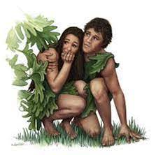
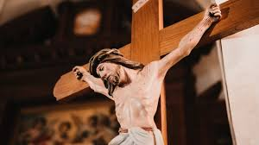
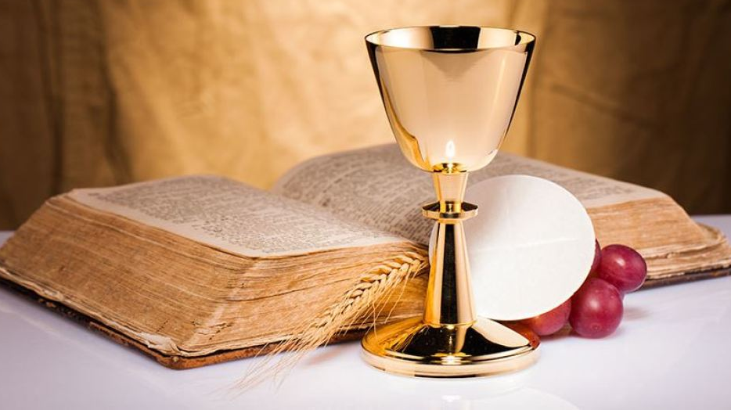
An example of how the concept of GRACE is build upon throughout student’s time at St Marks.
Year 10
In spring 2 students study Christian Beliefs (2) where we revisit the role of GRACE in line with Jesus’ great act of atonement. But we build upon this knowledge as students are introduced to the three theories behind Jesus’ role in salvation ( see page 4 of curriculum map). Further, in Summer A when we study Christian Practices (1) to this students built upon their knowledge of grace within the sacraments, as they study, baptism, the eucharist and the sacrament of reconciliation. Students are also asked to consider whether sacraments are even necessary to receive God’s grace when exploring how Quaker Christians worship God.
Year 9
When studying St Mark’s Gospel Jesus’ later ministry in Autumn B, we revisit the concept of grace, when studying Jesus’ crucifixion his atonement for the sins of humanity enables every human being to gain access to the great riches at Christ’s expense ( GRACE) .
Year 8
In Spring A when students study the topic of Eucharist, they learn how for Catholic, Orthodox and Anglican Christians a Sacrament is an outward sign of an inward grace, the sacraments are an outpouring of love that we do not deserve, yet are freely given.
Year7
When studying Covenant in summer B: Students read Genesis 3; the are introduced to the term GRACE ( Great Riches At Christs Expense) God’s unconditional love that we do not deserve. Adam and Eve’s actions in Genesis 3 means that humanity fell from God’s grace.

