Slide 1
DRAMA YEAR 7
Curriculum Knowledge organiser

Slide 2
What are the Big Ideas for Drama?
Story Telling
Creating a Character
Performance Skills
Scripts – from page to stage
Styles and Concepts

Slide 3
Curriculum Plan for Year 7 and how they link to the 5 Big Ideas:
Autumn Term 1 | Starting Drama | Performance Skills
Autumn Term 2 | Commedia Dell Arte | Creating a Character
Spring Term 1 | The Fog/ improvisation | Performance Skills
Spring Term 2 | Romeo and Juliet | Story Telling
Summer Term 1 | Anti-Bullying awareness | Style and Concepts (TIE)
Summer Term 2 | Aladdin | Scripts from Page to Stage

Slide 4
Introduction to the Subject of Drama
Big Idea:
The subject of drama is intended for students taking examinations in drama or theatre arts at GCSE level. Drama has an important role to play in the personal development of our students. The skills and qualities developed by students in drama, such as teamwork, creativity, leadership and risk-taking are assets in all subjects and all areas of life. Drama stimulates the imagination and allows students to explore issues and experiences in a safe and supportive environment.
It is vital to create an atmosphere of security, trust and concentration. Drama promotes self-esteem and provides all students with a sense of achievement regardless of academic ability.
It's about social skills, communication skills and learning by doing.
Key Skills and dramatic Techniques
Communication
Still Image
Character
Mime
Drama
Studio
Focus
Key Knowledge:
Students will develop an understanding of the ‘Drama Studio Rules’ to enable a successful drama lessons. Then use one or two drama techniques with some success in a piece of theatre, respond to questions and feedback in class with basic descriptive responses and learn how to choose some appropriate movement and voice for a basic character.

Slide 5
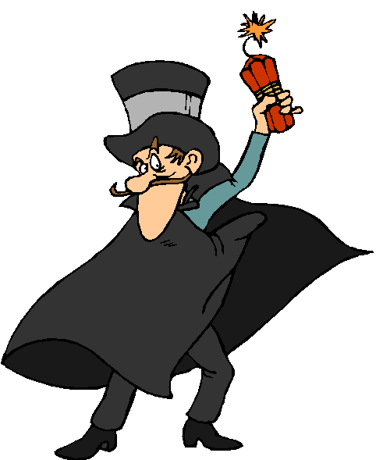
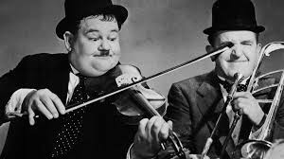
The Big Idea: CREATING A CHARACTER
Being able to create and play someone other than yourself is what acting is all about. Being able to change your voice and physicality to suit the role will enable you to play many different people. In year 7 you will get to experiment with your voice and movement to create different people in lots of different situations. Being able to ‘put yourself in someone else shoes’ will also help to develop empathy and consideration for others.
Commedia Dell Arte
Key Language:
Stock Character - A stereotypical person whom audiences readily recognize from frequent appearances in a particular literary tradition.
Slapstick comedy – A type of physical comedy characterized by broad humour.
Audience Participation- An active response by an audience to a live show or broadcast.
Hot seating: A technique used to find out more about a character
Sustain: The ability to stay in role for a period of time.
Improvisation: To make up the action as it goes along.
Characterisation: What an actor does to get into role.
Teacher in role – when the teacher becomes a character to teach the lesson.
Key Skills and dramatic techniques
Still Image
Hot seating
Improvisation
Mime
Narration
Role on the wall
Whole group drama
Teacher in role
TV interview techniques
Staying in role
Key Knowledge:
Students will learn the conventions of Commedia Dell Arte and develop their characterisation by using their voice and physicality to play a range of contrasting characters. An actor uses many different methods to get into role including method acting where they will fully immerse themselves into the role to enable them to really believe that they are the character. In year 7 students will explore the conventions of ‘Commedia Dell Arte ’ and apply them to improvised learning tasks and devised pieces of theatre.

Slide 7
Big Idea: STORYTELLING
At the heart of all good drama is a story. The art of story telling is one of the most necessary skills required to create meaningful and interesting dramatic work. In year 7 you will practically explore traditional stories from around the world along with well known tradition of tragic romances. You will look at how a story can be brought to life dramatically, the reoccurring characters that appear and the similar themes. You will also learn how to use your voice creatively to ensure you can fully engage an audience with your storytelling.
Romeo & Juliet
Key Knowledge:
Romeo and Juliet is the tragic story of two young people who come from two different households, who fall in love. Despite the fighting between their families the two central characters do everything they can to remain together.
For young people of all ages, this play is a fantastic way to explore the concepts of family and loyalty as well as looking at a range of themes & styles including:
Family Relationships
Fate and Destiny
Love
Character and motivation
Themes and ideas
The author’s craft
Plays in performance
Speaking and listening
Tragic love is shown through the play of Romeo and Juliet a lot and is probably one of the biggest themes the whole way through.
Key Language:
Narrator: An actor who delivers a commentary accompanying a play, film, broadcast, piece of music. The storyteller.
Actor: A person whose profession is acting on the stage, in films, or on television
Choral Speaking: The recitation of poetry or prose by a chorus or ensemble.
Culture: The ideas, customs, and social behaviour of a particular people or society
Tragic romances : Means a love that does not go smoothly or may end bad.
Still Image: A single frame forming a motionless image
Physical Theatre: A form of theatre which emphasizes the use of physical movement, as in dance and mime, for expression
Stagecraft: Skill or experience in acting in plays
Key Skills and dramatic Techniques
Communication
Still Image
Narration/ Narrator
Character
Physical Theatre
Stagecraft
Use of Voice/vocal skills
Chorus
Building Tension
Dramatic climax
Trust
Focus
control

Slide 8
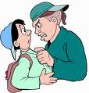
Big Idea: Styles and Concepts
The world of theatre and performance has a vast array of theatre styles and genres. It’s vital that an expert actor appreciates different theatre from around the world as well as from different periods in history. Knowing about the style of a performance is also crucial as this will allow the actor to experience a wide range of different characters and performances. In year 7 we explore theatre in Education through a Bullying scheme It will explore the following questions: - What is a peer and what is a friend? - Is it kind? Is it true? Do I need to say it? - What is a bully? - What are the different types of bullying? - What is a bystander? - What can we do to help stop bullying?
Anti-Bullying awareness (TIE)
Key Skills and dramatic Techniques :
Devising
Theatre in Education
Forum Theatre
Theatre style
Tragedy
Comedy
Satire
Genre
Concept
Theatre performance spaces
Abstract theatre
Slow motion
Key Language:
Antagonist - a person who actively opposes or is hostile to someone or something; an adversary
Convention - a way in which something is usually done
Moral - a lesson that can be derived from a story or experience
Playwright - a person who writes plays.
Protagonist - the leading character or one of the major characters in a play, film, novel, etc.
Tableaux - a group of models or motionless figures representing a scene from a story or from history
Empathise -Understand and share the feelings of another.
Social skills- Are the skills we use to communicate and interact with each other, both verbally and non-verbally, through gestures, body language and our personal appearance.
Key Knowledge:
Traditionally: 'Theatre in Education (TiE) is a process that uses interactive theatre/drama practices to help aid the educational process.' The Belgrade Theatre are pioneers in TiE who delivered a free TiE service to schools across Coventry between 1965 and 1996.
Theatre in Education can cover a variety of difficult themes and topics in a safe environment. In Year 7 the actors will explore with empathy what it’s like to be bullied, and what can be done to stop it or if they ever find themselves or a friend in the same situation.

Slide 9
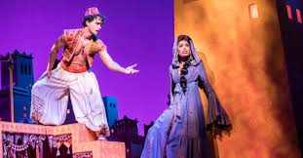
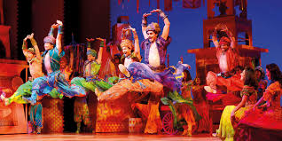
The Big Idea: Scripts – from page to stage
All actors will need to be able to read and interpret a text. Stage directions can help bring the words to life, but often the actor and director will need to work together to develop the words into a performance. You will explore a full text and the messages it offers. You will have the opportunity to analyse the text and explore excepts practically.
Aladdin
Key Skills and dramatic techniques:
Learning lines
Interpretation of text
Taking direction
Playwrights
Stage directions
Discipline and control
Staying in role
Literacy
Problem Solving
Key Knowledge:
Aladdin is one of the best known stories in Scheherazade's oeuvre — but it wasn't there originally. Aladdin, along with Ali Baba, is one of One Thousand and One Night's "orphan tales." They weren't a part of the initial Arabic text. Rather, they were added to a 1712 edition by the French translator Antoine Galland.
Scholars have not found a manuscript of the story that predates the version published in 1712 by Galland, who wrote in his diary that he first heard the tale from a Syrian storyteller from Aleppo named Hanna Diyab on May 8, 1709. French orientalist and archaeologist Antoine Galland (1646 - 1715)
This unit will explore sections of the script and look at how the actor and director can work together to bring the piece to life. Students will be able to interpret the play in their own style and consider the creative intention for the performance.
Key Language:
Cyclic - occurring in cycles; regularly repeated
Direct Address – An actor speaking directly to the audience
Dramatic Tension – A moment created by the action of a play
Flashback - a scene in a play, novel, etc. set in a time earlier than the main story
Freeze Frame – a group of actors creating a still image that represents part of a story
Monologue - a long speech by one actor in a play or film
Script - the written text of a play
Creative intention – what is the point of the play? What’s the message?

