Slide 1
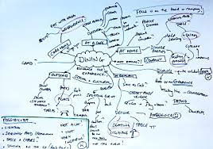
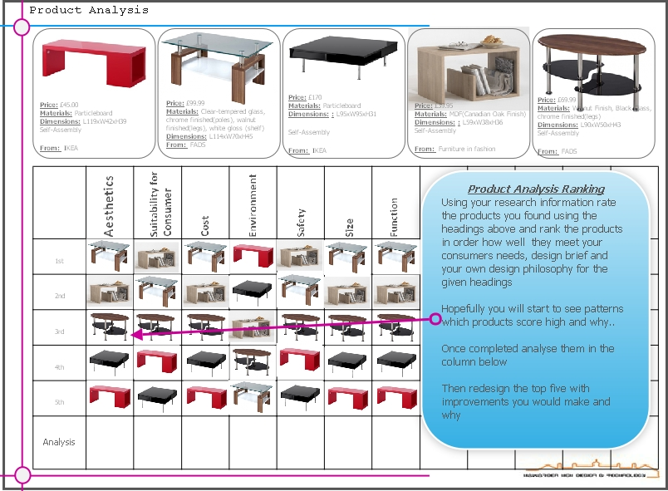
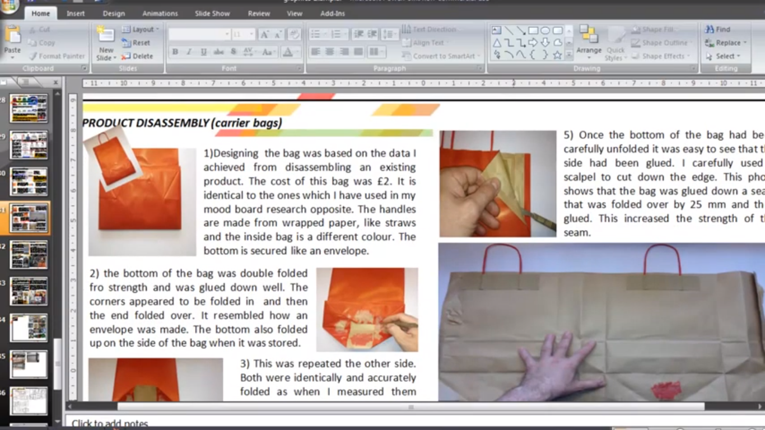
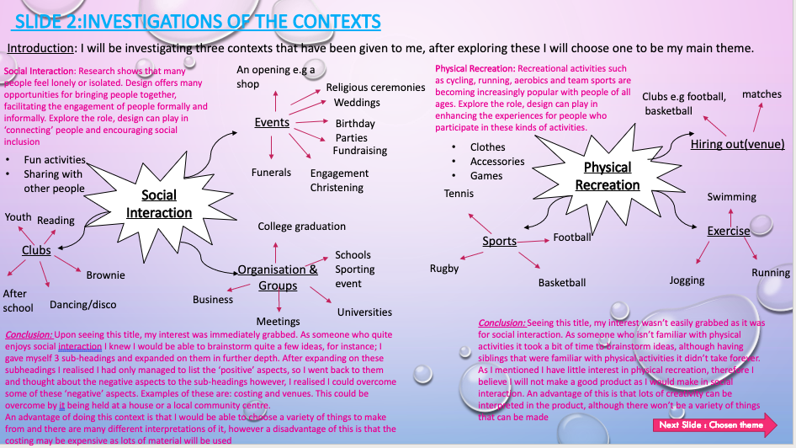
Y10 Graphics. Unit 1 Explore Design Problems and Designing for a User
Key Words & Vocabulary
Selecting a Design Theme
4.
Product Analysis and Product Disassembly
Design Theme
Design Problems
Design solutions
Designing for a User
5 W’S
Clients
Solutions
Design Support
Design Brief
Brand
Primary User
Secondary User
Inclusive Design
User Centred Design
Focus Group
Design Need
Product Disassembly
Smart and Modern Materials
Ergonomics
Anthropometrics
PUN
Technical Specification
4. Product analysis – conduct research around similar products. Discuss their unique features, functions and aesthetics – what your next steps of inspiration?
2
2. Select your preferred design theme and explore it further with a mind map. What solutions can you offer? Who can the users be? What problem will it solve? What are your next steps?
4. Product disassembly – conduct product disassembly of a real life product. Look at it in terms of LCA – what features would you improve? Why? What are your Next Steps?
Mind Mapping the Design Problem
Customer Profile Primary and Secondary Users
and Design Brief
User & Stakeholder Interview about their product needs and PUN checklist
5.
1
3
What are the 3 NEA Design themes?
Task: Mind Map all 3 and think of solutions – Next steps –which one will you choose and why?
3. Mind Map your users and stakeholders? Who are they why? Where do they shop? Need? Use the 5 W’s to explore your brief.
Type your brief as a paragraph explaining each W and explore your exact users and stakeholders
5. What do your User and Stakeholders want from the product you are designing? No better way than to ask! Interview your Users and Stakeholders about what they want the product to do and why? Create a PUN check list based on this to help guide your designs
1. Start by mind mapping all 3 design themes. What design need can they offer? What problems? What creative ideas can you come up with?
Explore
Design
Create
Make
Evaluate

