Slide 1
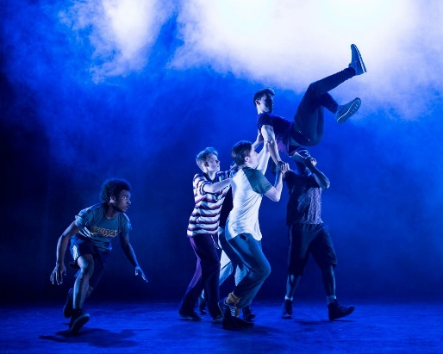
Big Idea: Creating a Character
An exploration of techniques created by an industry leading company to help create characters. Frantic Assembly tell stories using physicality and movement of the body. In year 8 students will learn how to lead a physical warm up, and use physical theatre as a technique to dramatically and creatively tell a story. In year 8 the actors create their own superheroes and consider how their ‘superpowers’ could be shown on stage.
Superheroes
Key Language:
Devising – plan or invent a new piece of theatre
Exploration - thorough examination of a subject or new technique
Facial Expression - one or more positions of the muscles beneath the skin of the face.
Gesture - a movement of the hand/arms or head to express an idea or meaning.
Innovative – featuring new methods; advanced and original.
Interpretation – the action of explaining the meaning of something
Physicality/body language - the physical features of a person, the conscious and unconscious movements and postures by which attitudes and feelings are communicated
Relaxation - the state of being free from tension.
Tension - the state of being stretched tight.
Key Skills:
Analysis
Collaboration
Concentration
Focus
Imagination
Physical Theatre
Key Knowledge:
Frantic Assembly was founded in 1994 by Scott Graham, Steven Hoggett and Vicki Middleton. They are an industry leading company who have worked on famous productions such as The Curious Incident of the Dog in the Night-Time. Frantic Assembly use building blocks in order to devise new and innovative theatre. Frantic Assembly’s pieces are created step by step with the story being added last. The story is often interpreted by the audience.
In Year 8 they will explore what it’s like to be a superhero. They will create their own hero deciding what super powers they have, and then create a back story as to how they came to be super!
YEAR 8 KNOWLEDGE ORGANISER – DRAMA

Slide 2
Big Idea: Style and concepts
Verbatim theatre is a form of documented theatre in which plays are constructed from the precise words spoken by people interviewed about a particular event or topic. In year 9 we use the real story of Stephen Lawrence, and the real words documented in his trial know as ‘the colour of justice.’ Year 9 actors will lean the technique of debating where they will be asked to respond to controversial topics and consider how this case changed the British justice system.
The colour of Justice – Stephen Lawrence
Key Knowledge:
Stephen Lawrence was a black British teenager from south east London, who was murdered in a racially motivated attack while waiting for a bus on the evening of 22 April 1993.
After the initial investigation, five suspects were arrested but not charged. It was suggested that he was killed because he was black, and that the handling of the case by the police was affected by issues of race. A 1998 public inquiry, examined the original investigation and concluded that the force was institutionally racist. It also recommended that the double jeopardy rule should be repealed in murder cases to allow a retrial upon new and compelling evidence. The report has been called "one of the most important moments in the modern history of criminal justice in Britain".
Key Language:
Alienation – It involves the use of techniques designed to distance the audience from emotional involvement in the play through jolting reminders of the artificiality of the theatrical performance.
Direct address - Speaking directly to the audience breaks the fourth wall and destroys any illusion of reality.
Narration - Remind the audience that what they’re watching is a presentation of a story.
Placards – A sign or additional piece of written information presented onstage. Using placards might be as simple as holding up a card or banner. Multimedia or a PowerPoint slideshow can also be used for this effect.
Prejudice - Prejudice is an affective feeling towards a person or group member based often on that person's group membership. The word is often used to refer to preconceived feelings towards people or a person because of their political affiliation, sex, gender, beliefs, values, social class, age, disability, religion, sexuality or race/ethnicity.
Key Skills:
Verbatim theatre
Forum theatre
Empathy
Thought tracking
Hot seating
Debating
Abstract techniques
YEAR 8 KNOWLEDGE ORGANISER - DRAMA

Slide 3
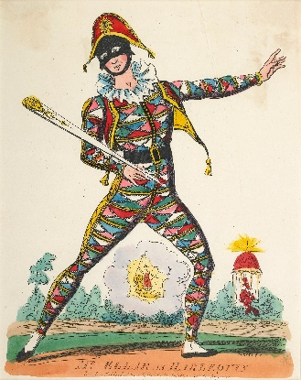
The Big Idea: Performance Skills
Commedia dell'Arte (which translates as “theatre of the professional”) began in Italy in the early 16th Century and quickly spread throughout Europe, creating a lasting influence on Shakespeare, Molière, opera, vaudeville, contemporary musical theatre, sit-coms, and improvisational comedy. All actors learn Commedia, as the stock characters appear in every modern play in different guises. In year 8 students will explore the 6 main characters from commedia including Il Capitano, Il Dottore and the Zanni.
Commedia Dell Arte
Key Language:
Exaggeration – Over the top gestures or facial expressions
Harlequin and Columbina-Servants of higher status
Il Capitano - the Captain, boastful, braggart but cowardly
Il Dottore - the Doctor, windbag.
Innuendo-an allusive remark typically suggestive or disparaging.
Pantalone-old ,rich man,miser
Physicality – A characters stance and body language
Status – Refers to a characters place in society in the world that they live in.
Stock-characters - stereotypical fictional characters who audiences recognise from their frequent recurrences.
The Lovers-Isabella and Flavio infatuated with each other.
Zanni - servants/clowns of various status.
Key Knowledge:
Comedy of the Arts was developed in Italy in the 16th Century. It’s roots are in traditional clowning, Story-telling and travelling Minstrels.
Companies toured from town to town with performances taking place outside in the market squares.
The performances were loud, colourful and gestures were exaggerated so that everyone could clearly see. This is where
slap-stick comedy originates from. It’s called ‘slapstick’ comedy, as they used two pieces of wood strapped together to make a slapping sound when it was hit.
Key Skills and techniques:
Audience participation
Comic timing
Exaggerated gestures and physicality
Loud confident characterisation
Use of slap-stick comedy and clowning
Status
Using masks
Tragedy
Comedy
Satire
YEAR 8 KNOWLEDGE ORGANISER – DRAMA

