Slide 1
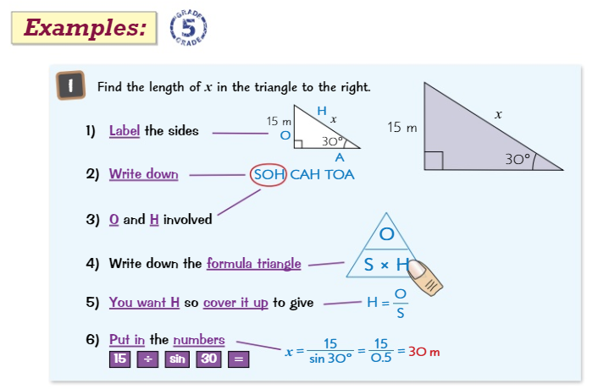
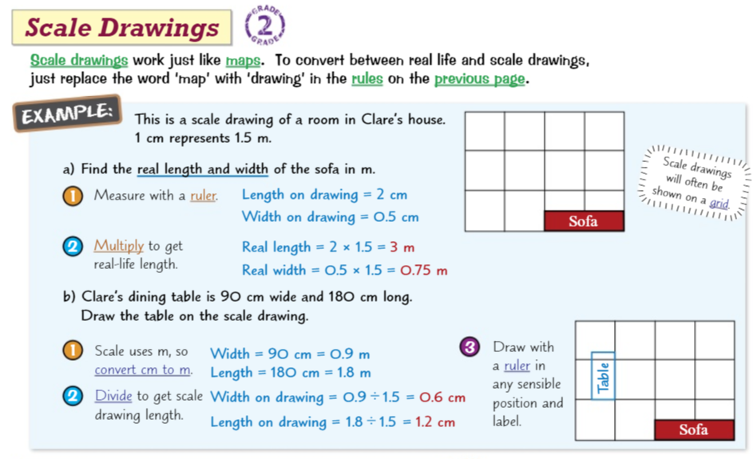
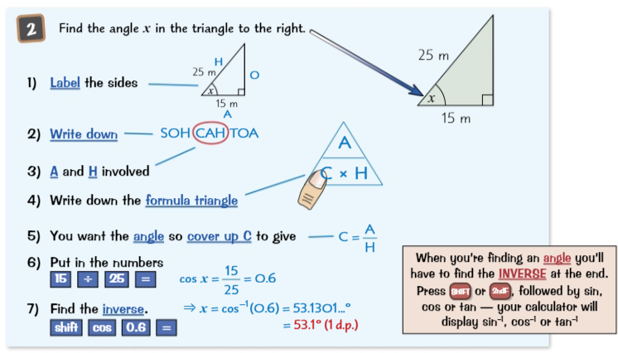
Knowledge Organiser: Mathematics
Year 9 Foundation Summer Term 2
Suggested websites: Maths Genie, Save My Exams and Corbett Maths
Big Idea: Geometry and Measures
Key Skills:
Map Scales, Scale Drawing, Pythagoras Theorem, Trigonometry Ratio
Key Vocabulary
Hypotenuse, Adjacent, Opposite, Tangent, Sine, Cosine, Scale, Ratio

Slide 2
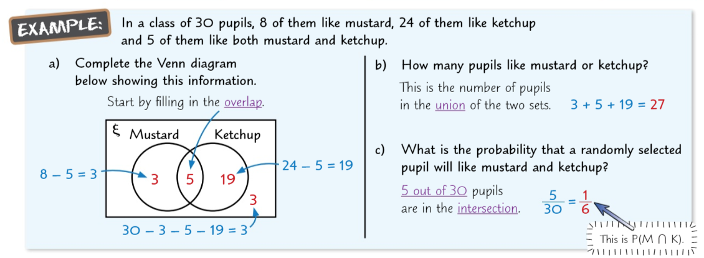
Knowledge Organiser: Mathematics
Year 9 Foundation Summer Term 2
Suggested websites: Maths Genie, Save My Exams and Corbett Maths
Big Idea: Probability and Statistics
Key skills:
Relative Frequency
Venn Diagrams
Tree Diagrams
Key Vocabulary
Union, intersection Relative Frequency, Probability, Outcomes,Event,Complement

