Slide 1
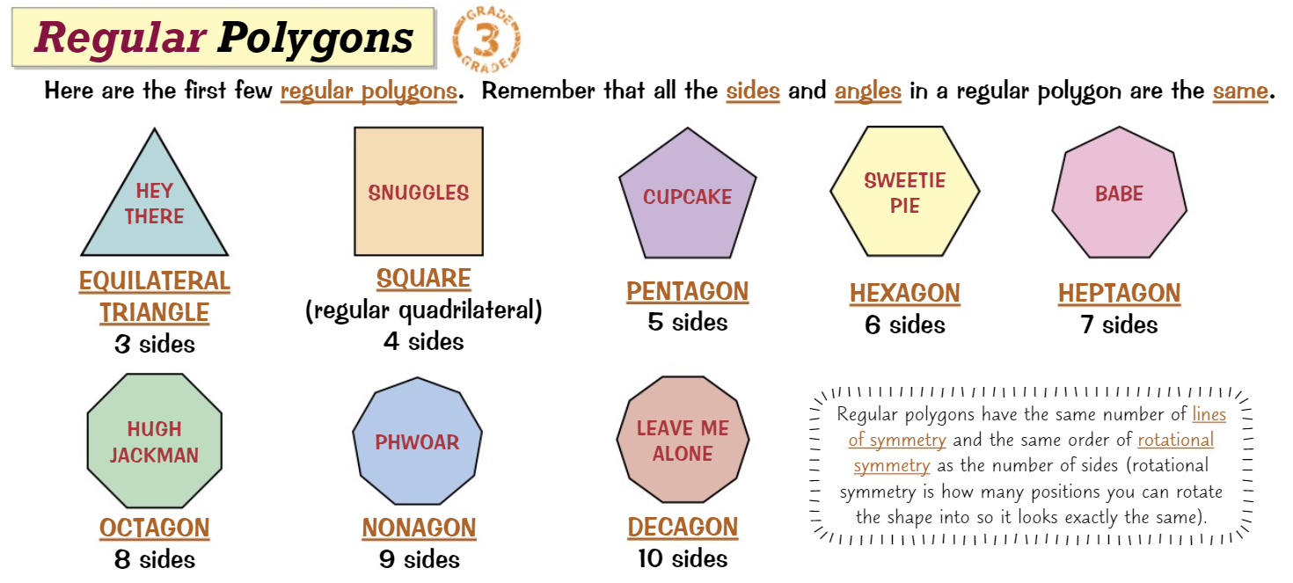
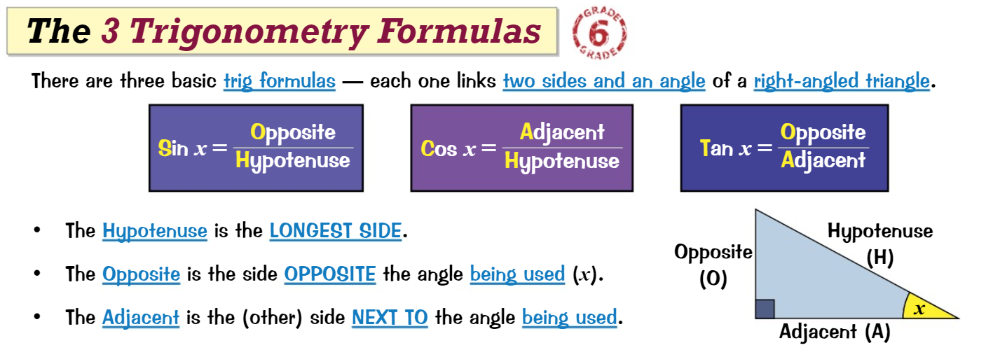
Knowledge Organiser: Mathematics
Year 9 Higher Spring Term 2
Suggested websites: Maths Genie, Save My Exam and Corbett Maths
Key Vocabulary
Opposite, Adjacent, Hypotenuse, Alternate, Corresponding, Co-Interior, Exterior, Interior Polygon, Parallel, SOH CAH TOA, Square Root
Big idea: Geometry and Measure
Key skills:
Angle properties of triangles and quadrilaterals, Interior & Exterior Angles of a polygon, Pythagoras’ theorem, Trigonometry, Problem Solving

