Slide 1
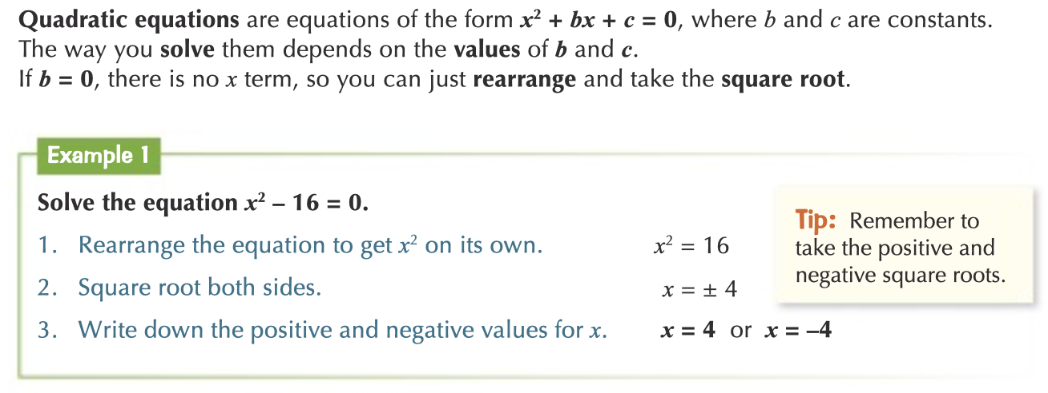
Knowledge Organiser: Mathematics
Year 10 Foundation Summer Term 1
Suggested websites: Maths Genie, Save My Exam and Corbett Maths
Key Vocabulary
Expand, Coordinates, Coefficient
Terms
Big idea: Algebra (quadratics equations and graphs)
Key skills:
Expanding double brackets, Plotting and using Quadratic Graphs
Factorising Quadratic expressions, Solving Quadratic equations

Slide 2
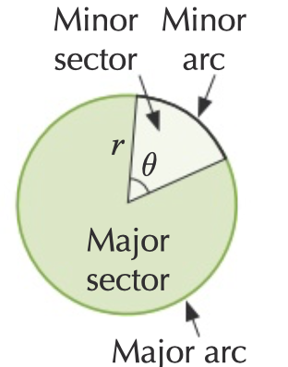
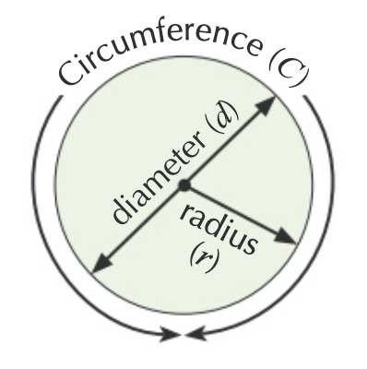
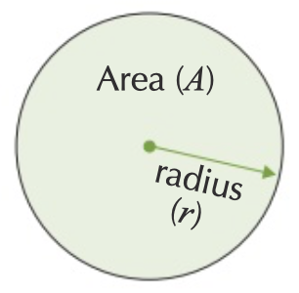
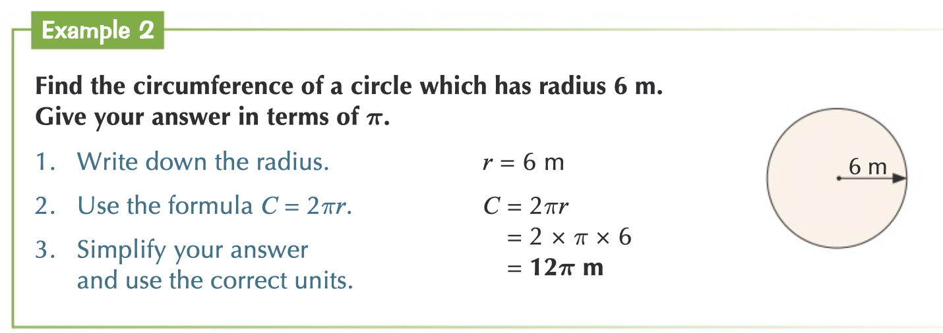
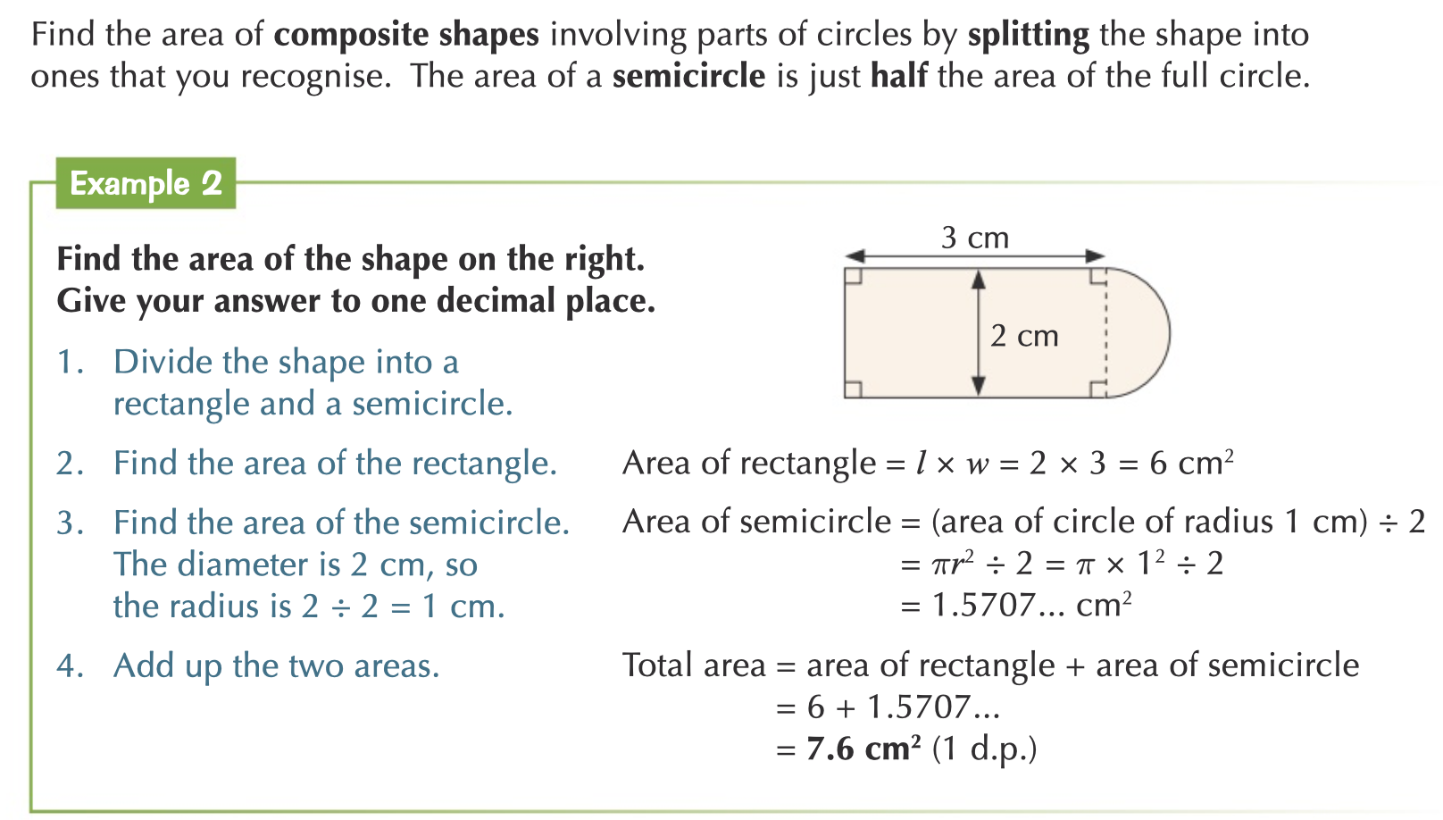
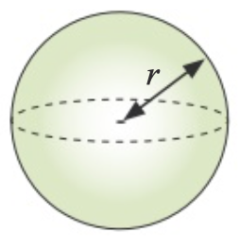
Knowledge Organiser: Mathematics
Year 10 Foundation Summer Term 1
Suggested websites: Maths Genie, Save My Exam and Corbett Maths
Big idea: Geometry and Measures
Key skills:
PERIMETER, AREA AND VOLUME. Circumference of circle, Area of Circle, Semicircles and Sectors, Composite shapes & Cylinders, Pyramids, Cone, spheres
Key Vocabulary
Radius, sector, segment
Diameter, chord

