Slide 1
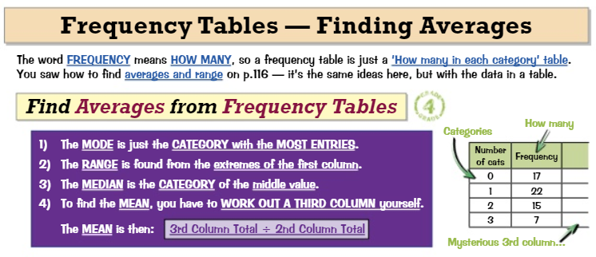
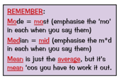
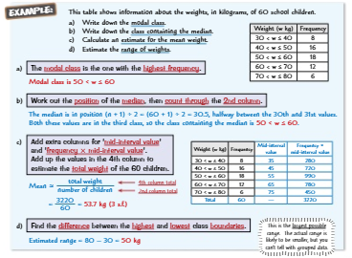
Knowledge Organiser: Mathematics
Year 9 Foundation Summer Term 1
Suggested websites: Maths Genie, Save My Exam and Corbett Maths
Key Vocabulary
Frequency , Tally, Mean, Mode, Median, Range, Mid point, Estimate
Big idea: Probability and Statistics
Key skills:
Calculate mean, mode, median and range
Investigate sampling
Estimate for the mean using a grouped frequency table

Slide 2
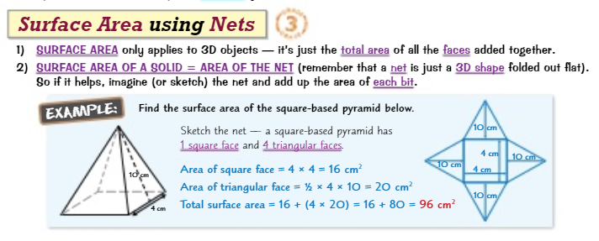
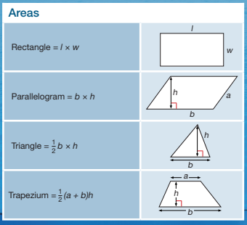
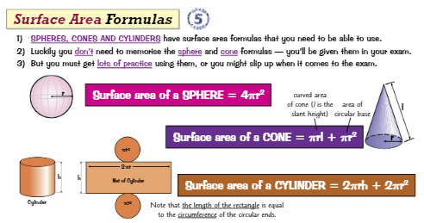
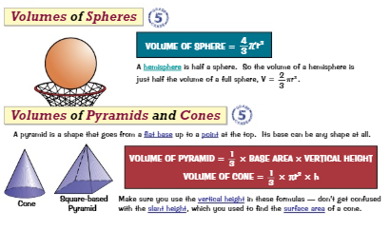
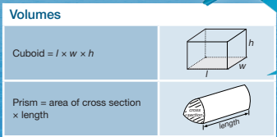
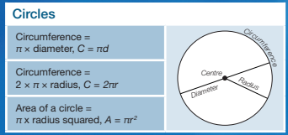
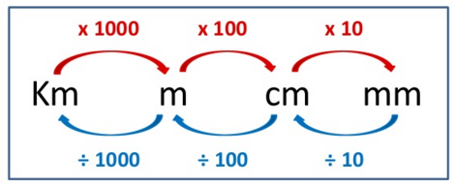
Knowledge Organiser: Mathematics
Year 9 Foundation Summer Term 1
Suggested websites: Maths Genie, Save My Exam and Corbett Maths
Key Vocabulary
Length, Width, Base, Height, Capacity, Litre, Face, Prism
Big idea: Geometry
Key skills:
Calculate area of shapes, including compound shapes
Calculate surface area and volume of 3D solids
Problem solving
FORMULAS YOU MUST KNOW:
For Area – use standard length conversions SQUARED² For Volume – use standard length conversions CUBED³

