Slide 1
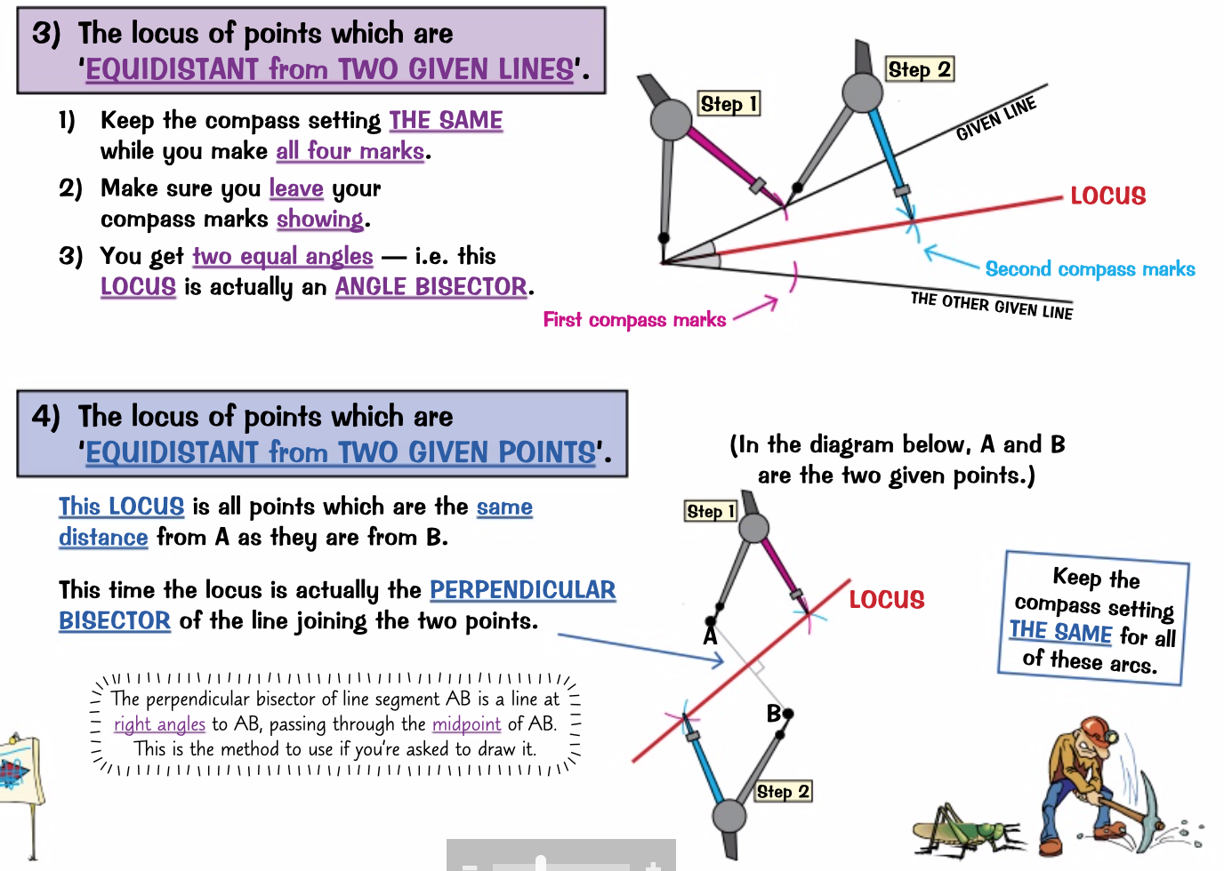
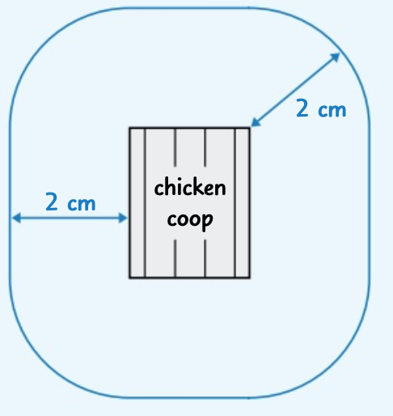
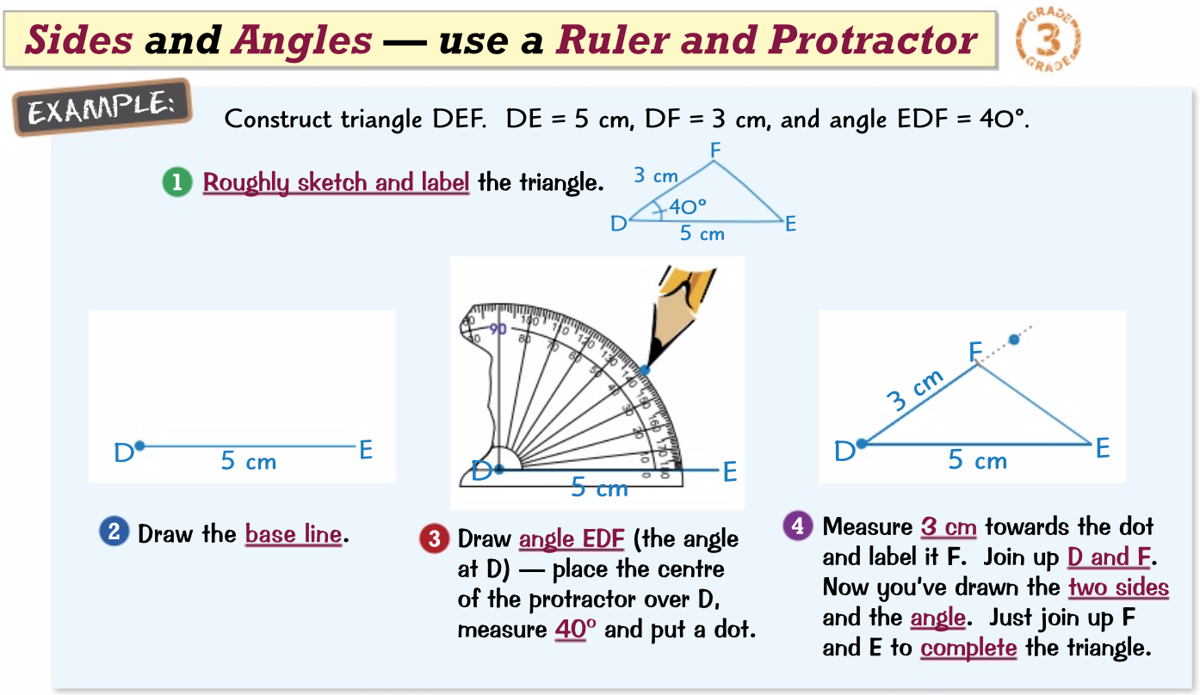
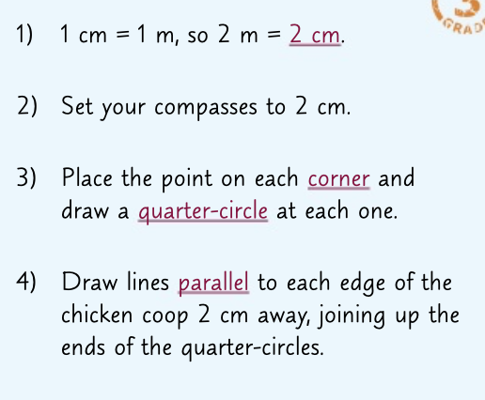
Knowledge Organiser: Mathematics
Year 10 Foundation Summer Term 2
slide 1/2
Suggested websites: Maths Genie, Save My Exam and Corbett Maths
Key Vocabulary
Compass Protractor
Bisect Clockwise
Anticlockwise
Three Figures
Big idea: Geometry and Measures
(Constructions, loci and bearings)
Key skills:
3D Solids, Plans and Elevations, Accurate drawings
Scale drawing and maps, Constructions, Loci and regions
Bearings, Problem Solving

Slide 2
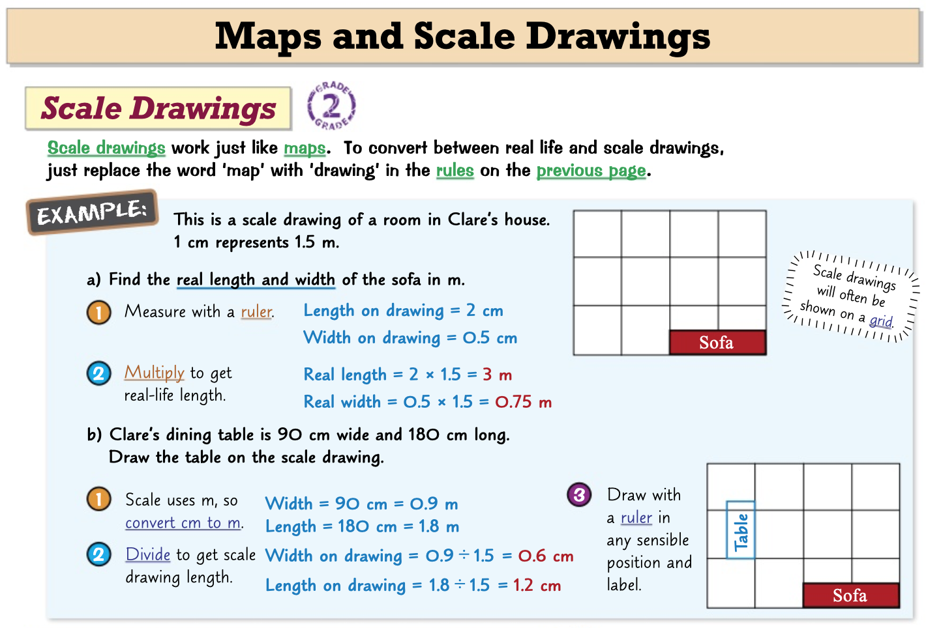
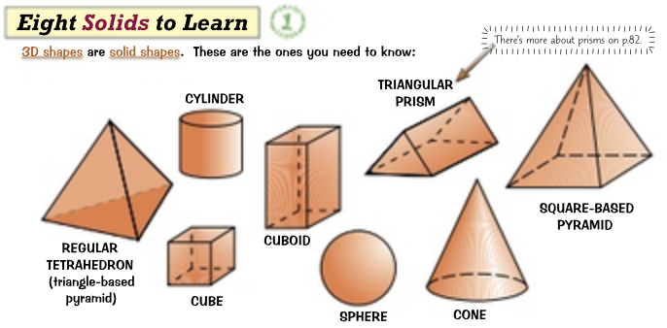
Knowledge Organiser: Mathematics
Year 10 Foundation Summer Term 2
slide 2/2
Suggested websites: Maths Genie, Save My Exam and Corbett Maths
Key Vocabulary
Compass Protractor
Bisect Clockwise
Anticlockwise
Three Figures
Big idea: Geometry and Measures
(Constructions, loci and bearings)
Key skills:
3D Solids, Plans and Elevations, Accurate drawings
Scale drawing and maps, Constructions, Loci and regions
Bearings, Problem Solving

