Slide 1
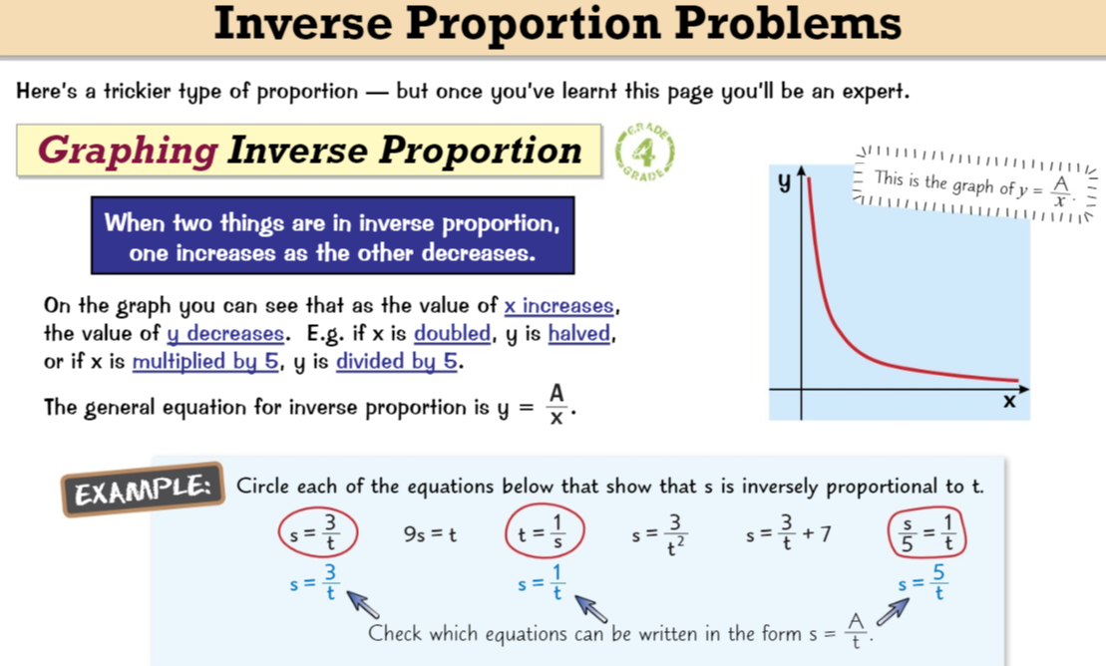
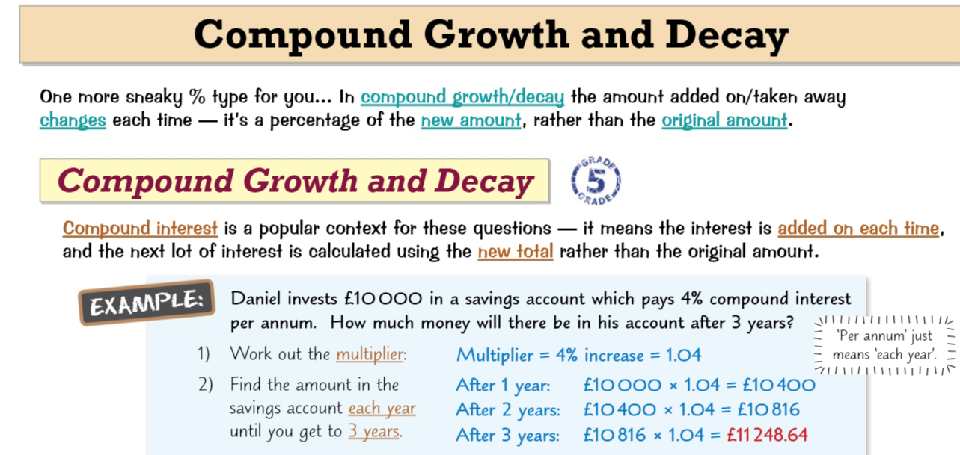
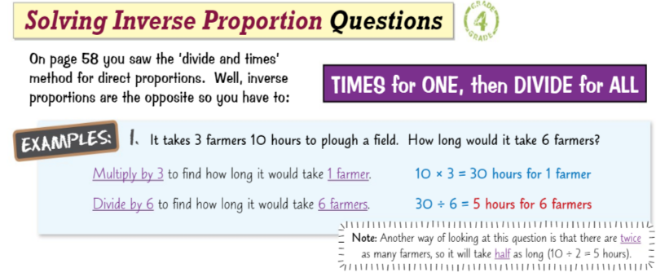
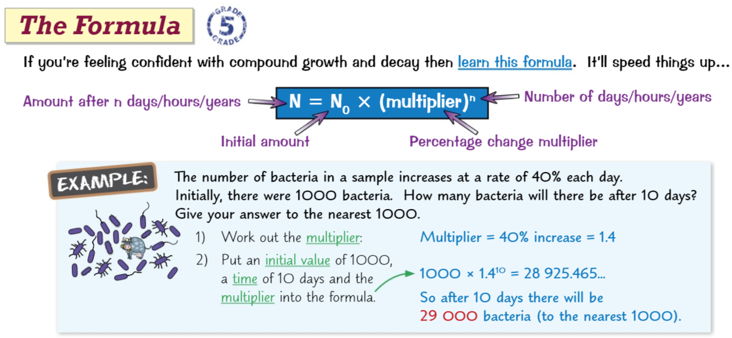
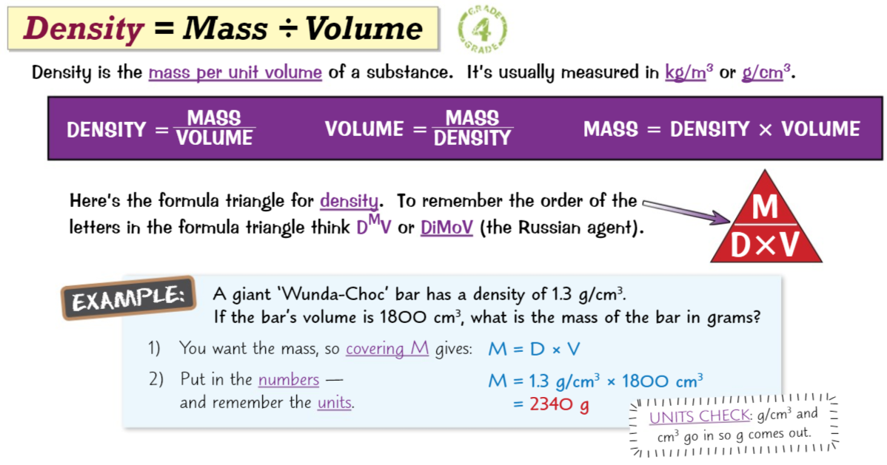
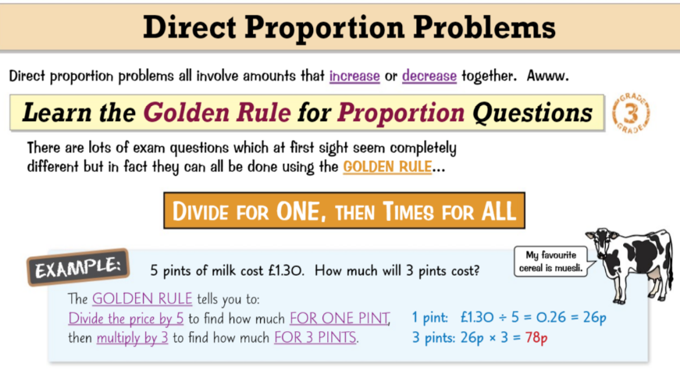
Knowledge Organiser: Mathematics
Year 10 Foundation Spring Term 2
Suggested websites: Maths Genie, Save My Exams and Corbett Maths
Big idea: Ratio Proportion and Rates of change
Key skills:
Solve Compound Growth &Decay problems
Solve speed, distance and time problems
Solve density , mass volume problems
Solve direct and inverse proportion problems
Key Vocabulary
Growth, Decay, Principal, Speed, Time, Distance, Density, Pressure, Force, Area, Proportion, mass, volume

