Slide 1

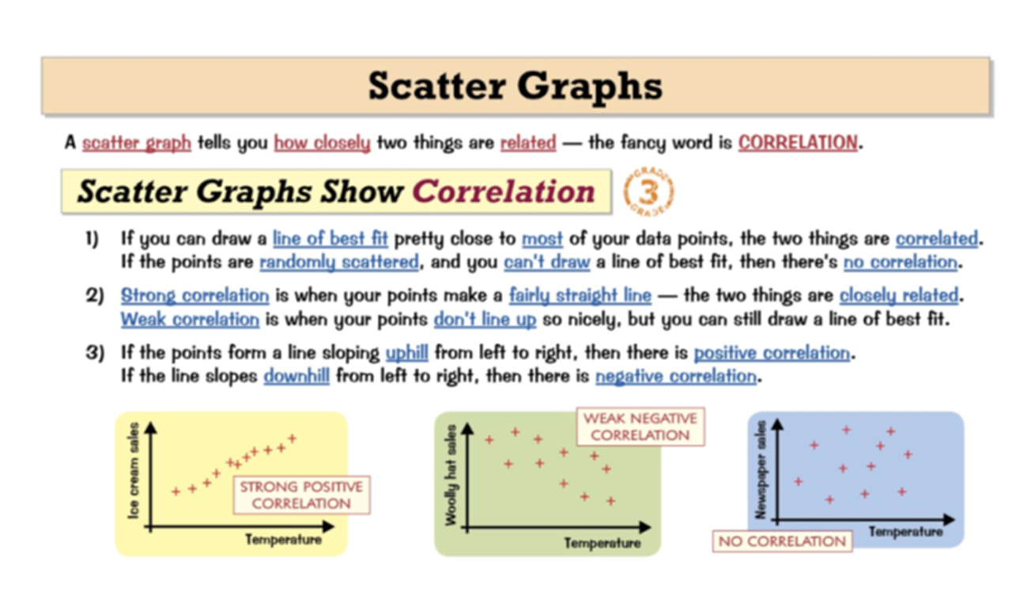
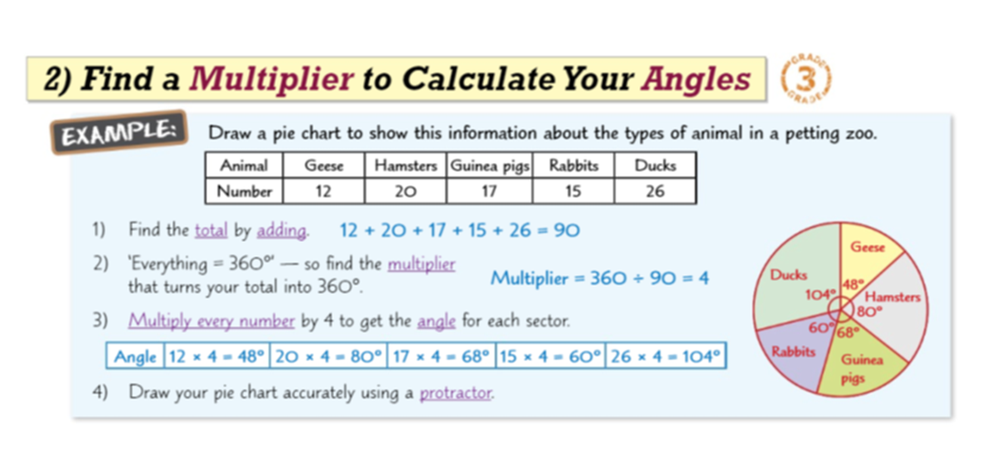
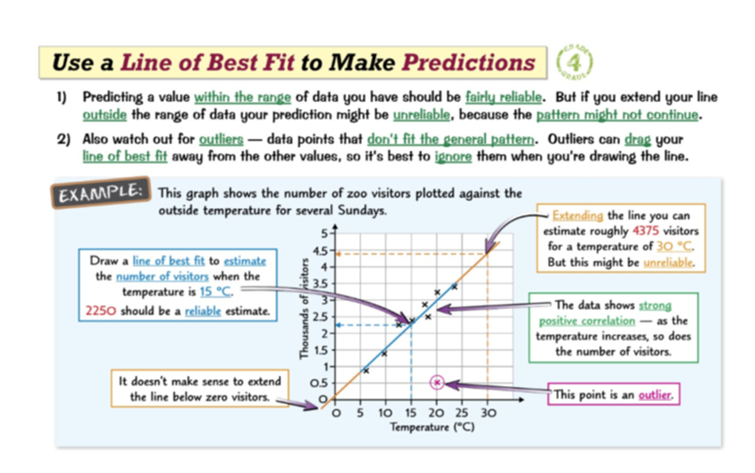
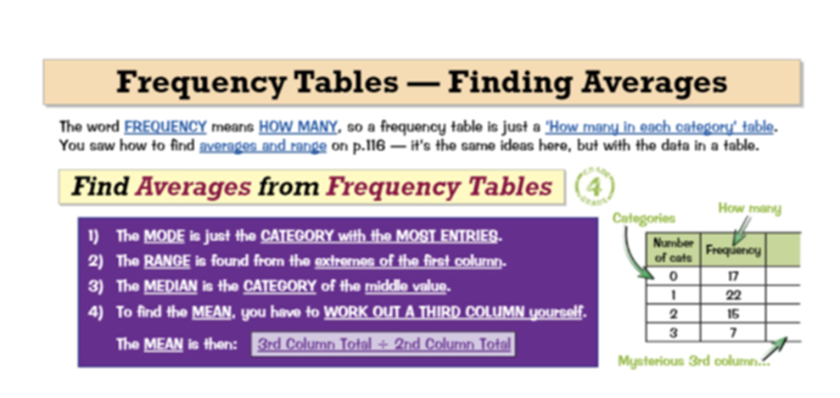
Knowledge Organiser: Mathematics
Year 9 Higher Spring Term 1
Suggested websites: Maths Genie, Save My Exam and Corbett Maths
Big idea: Probability and Statistics
Key skills:
Draw and interpret two way tables
Draw and interpret Pie charts
Draw and interpret Time Series graph
Draw and interpret Stem and leaf Diagrams
Draw and interpret Scatter Graphs
Estimate the mean from group data
Key Vocabulary
Frequency, Tally, Mean
Mode, Median, Angle
Circle, Protractor, Range
Correlation, Coordinate, Proportion, Outliers, sector

Slide 2
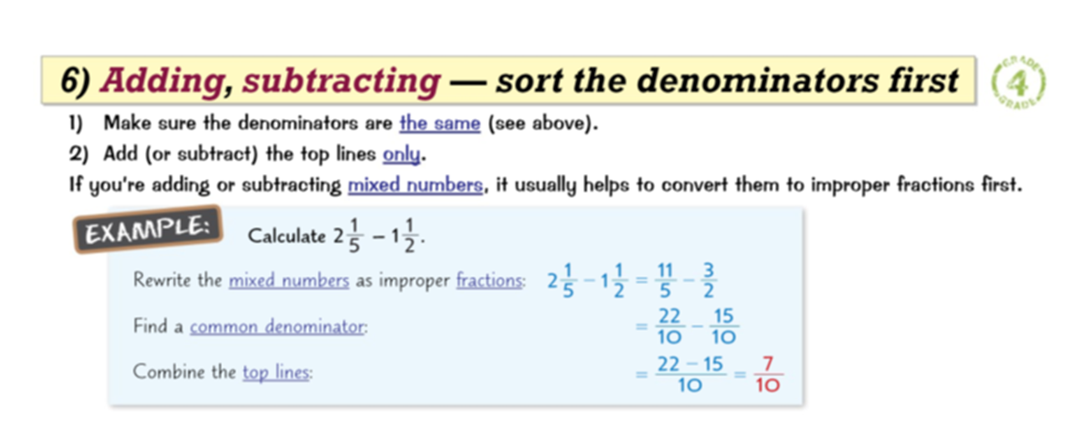
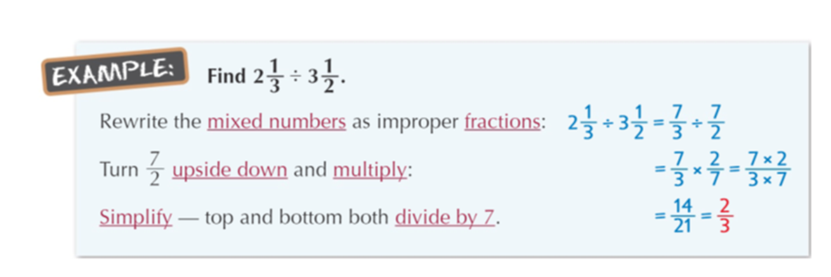
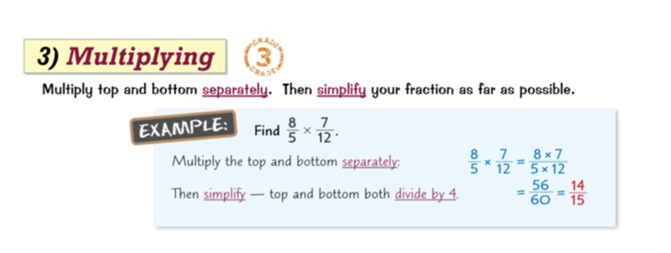
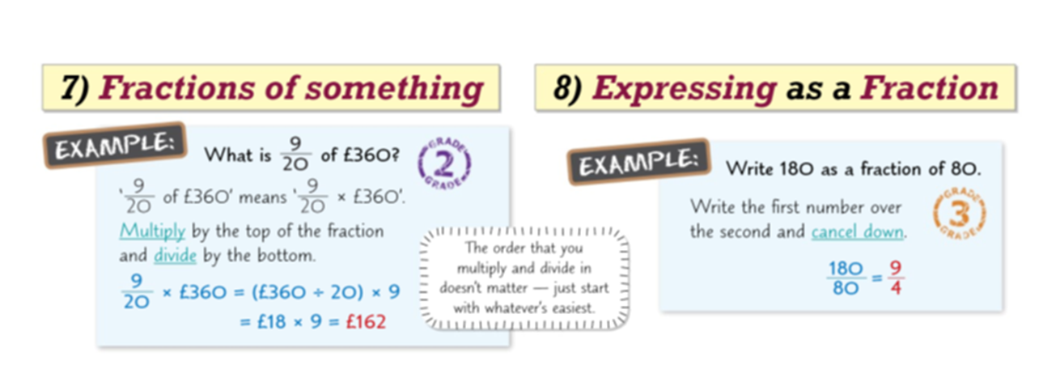
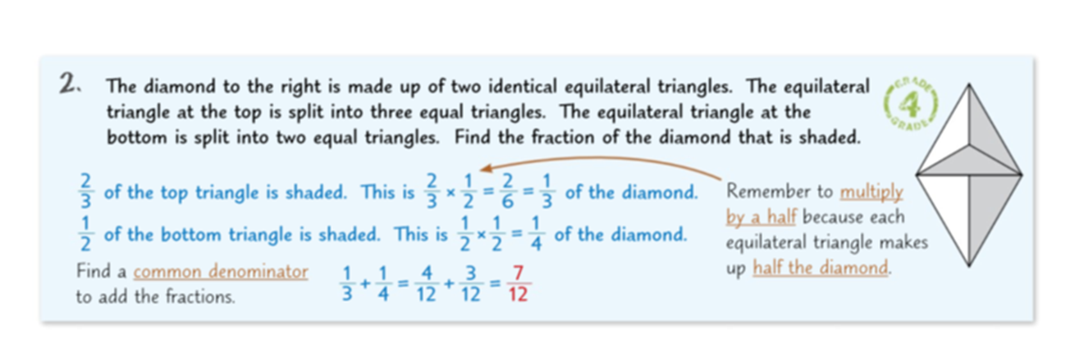
Knowledge Organiser: Mathematics
Year 9 Higher Spring Term 1
Suggested websites: Maths Genie, Save My Exam and Corbett Maths
Big idea: Number
Key skills:
Conversions between Fractions, decimals and percentages
Add and subtract fractions
Multiply and divide fractions
Convert fractions to decimals
Express one number as a fraction of the other
Calculate percentage change
Solve problems involving reverse percentages
Key Vocabulary
Mixed number, Equivalent fraction
Simplify, Proper fraction,
improper fraction, top-heavy fraction,
Numerator, denominator, Decimal, Equivalent

