Slide 1
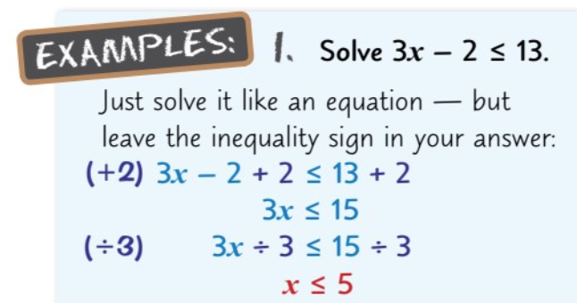
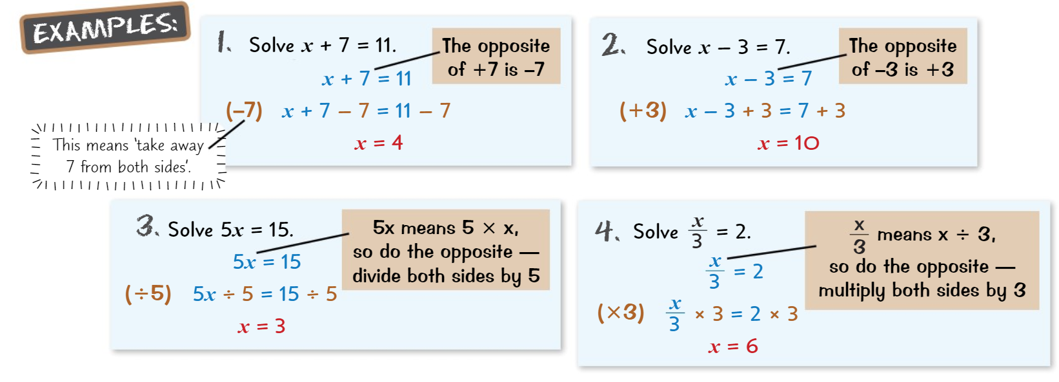
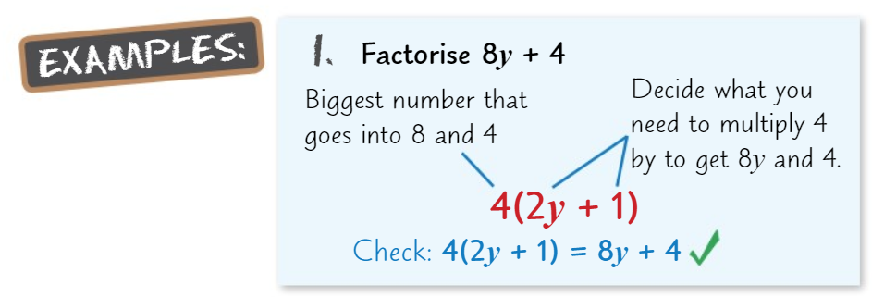
Knowledge Organiser: Mathematics
Year 9 Foundation Spring Term 2
Suggested websites: Maths Genie, Save My Exam and Corbett Maths
Big idea: Algebra
Key skills:
Solving Equations, Inequalities, Generating Sequences , Using nth Term, Problem Solving.
Key Vocabulary
Sequence, Linear, Term, Difference, Term-to-term rule, Position-to-term rule, Ascending, Descending.

