Slide 1
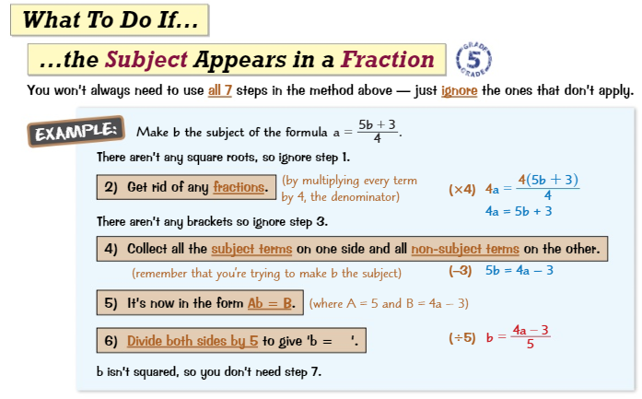
Knowledge Organiser: Mathematics
Year 10 Higher Autumn Term 2
Suggested websites: Maths Genie, Save My Exam and Corbett Maths
Big idea: Algebra
Key skills:
Expanding and Factorising
Changing the Subject
Functions
Key Vocabulary
Expand, Simplify, Coefficient,
Factorise, Terms, Brackets, Like Terms

Slide 2
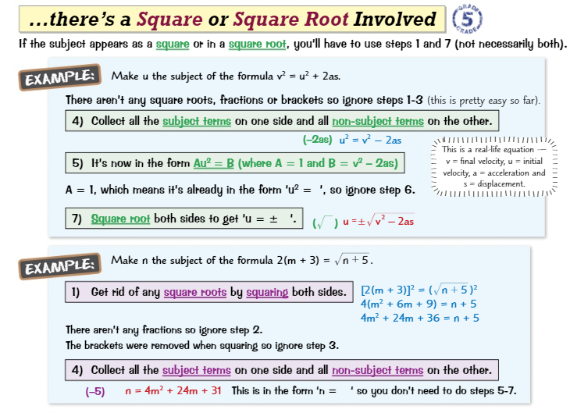
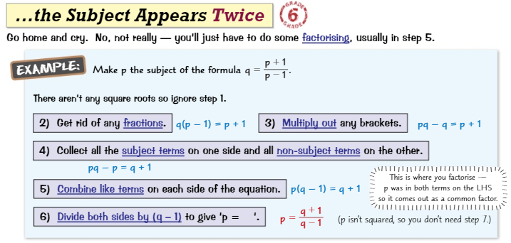
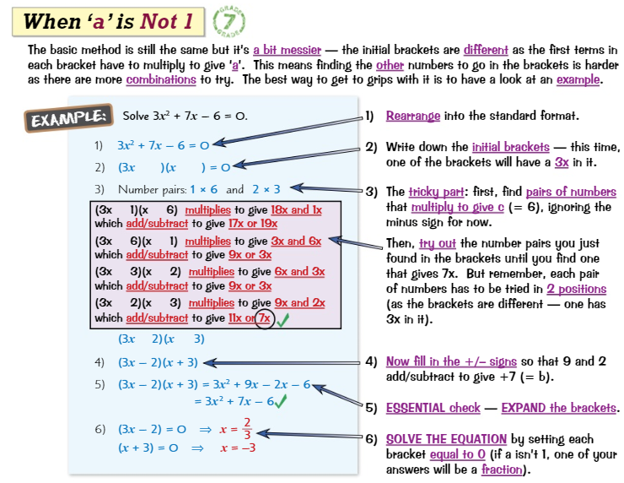
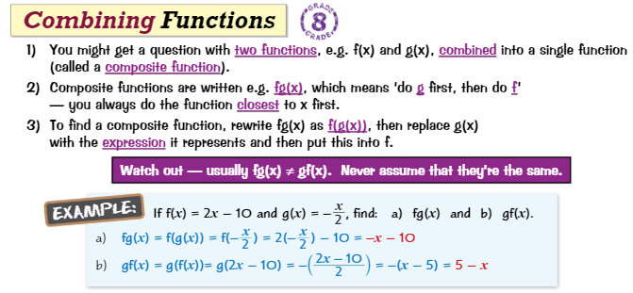
Knowledge Organiser: Mathematics
Year 10 Higher Autumn Term 2
Suggested websites: Maths Genie, Save My Exam and Corbett Maths
Big idea: Algebra
Key skills:
Expanding and Factorising
Changing the Subject
Functions
Key Vocabulary
Quadratic, Expression, Coefficient, Evaluate, Functions, Substitute,

