Slide 1
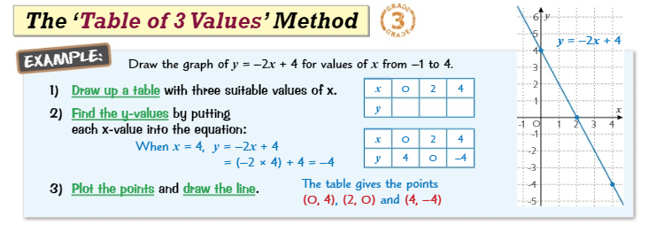
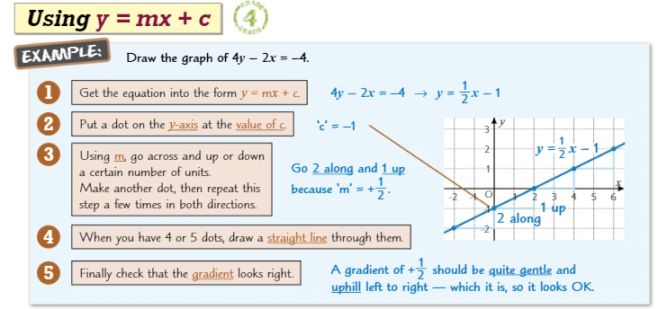
Knowledge Organiser: Mathematics
Year 10 Higher Autumn Term 1
Suggested websites: Maths Genie, Save My Exam and Corbett Maths
Big idea: Algebra
Key skills:
Gradients and lines
Non-linear Graphs
Using Graphs
Key Vocabulary
Linear, Gradient, Coordinate, Quadratic, Non Linear, Slope, Steepness, Reciprocal, Plott, Origin

Slide 2
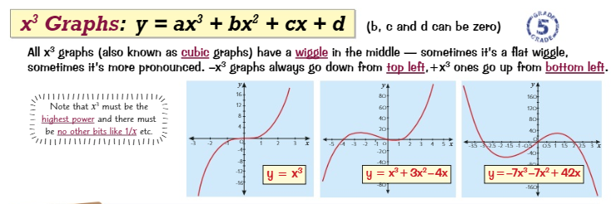
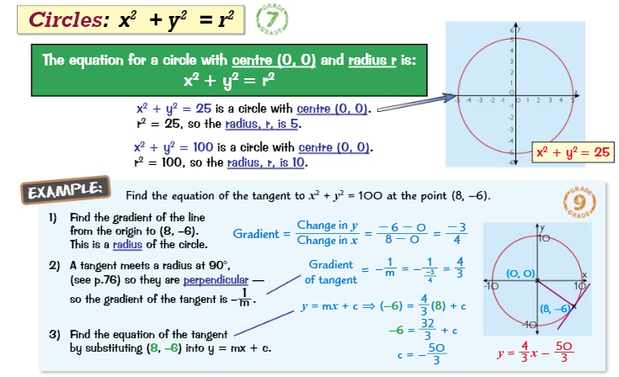
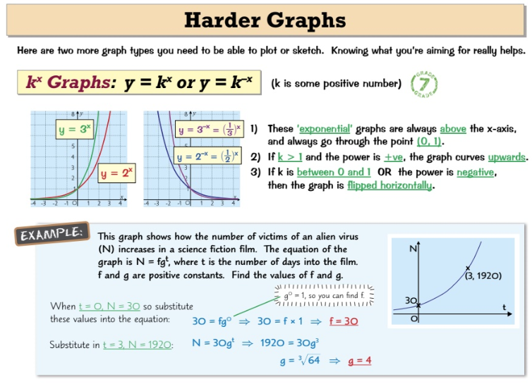
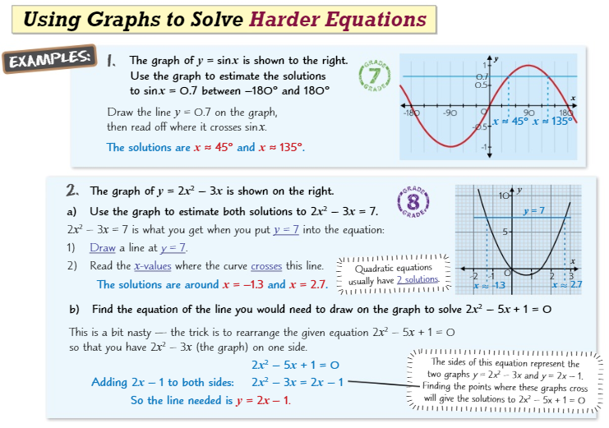
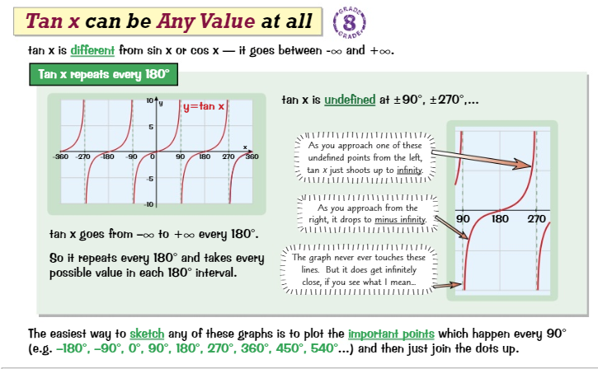
Knowledge Organiser: Mathematics
Year 10 Higher Autumn Term 1
Suggested websites: Maths Genie, Save My Exam and Corbett Maths
Big idea: Algebra
Key skills:
Gradients and lines
Non-linear Graphs
Using Graphs
Key Vocabulary
Circle, Reciprocal, Sine, Cosine, Tangent, Cubic, Cycle, Wave, Shift

