Slide 1

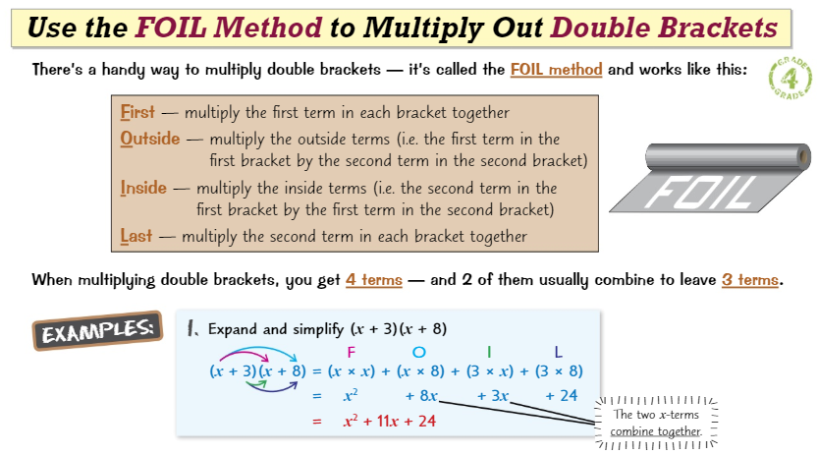
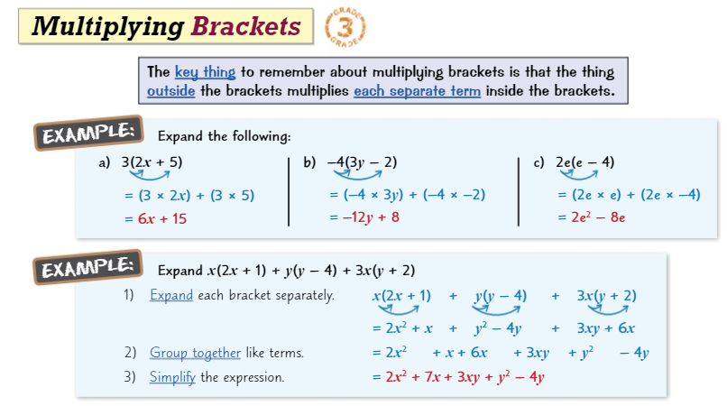
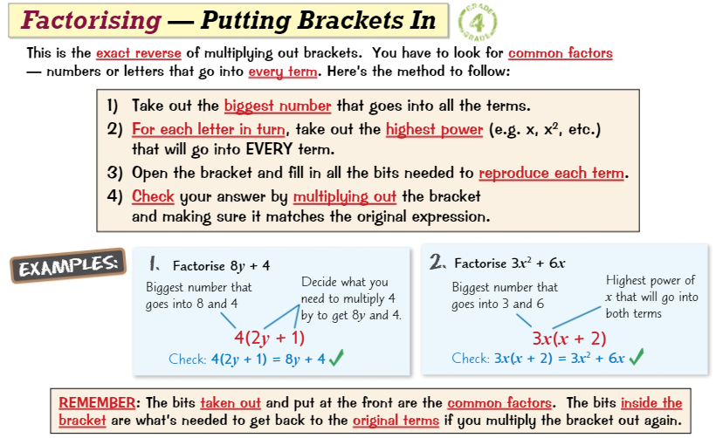
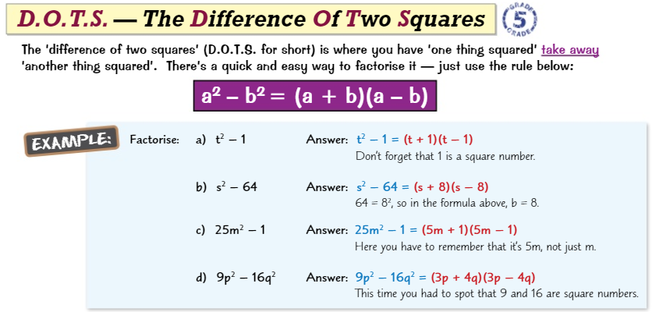
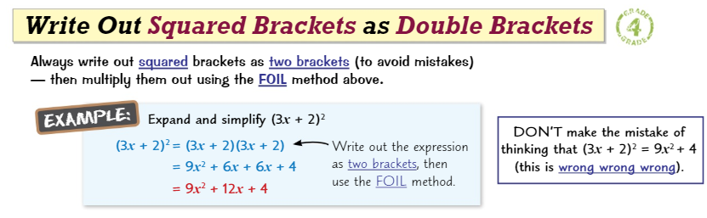
Knowledge Organiser: Mathematics
Year 10 Foundation Autumn Term 2
Suggested websites: Maths Genie, Save My Exam and Corbett Maths
Big idea: Algebra
Key skills:
Expanding and Factorising
Changing the Subject
Functions
Key Vocabulary
Expand, Simplify, Coefficient,
Factorise, Terms, Brackets, Like Terms, Quadratic

Slide 2
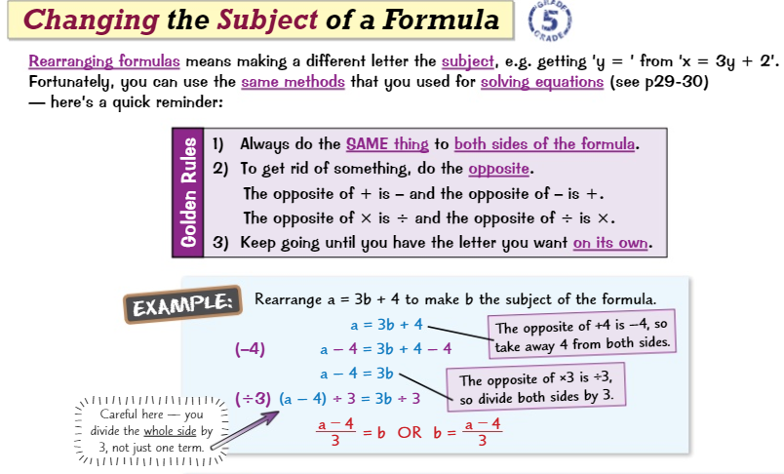
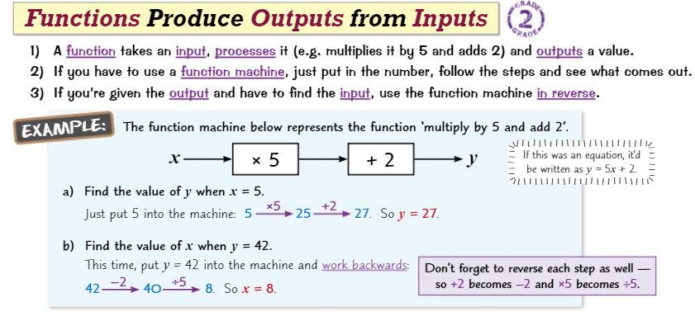
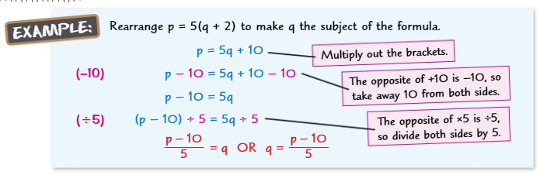
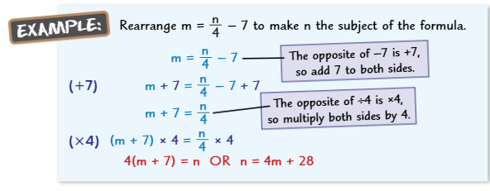
Knowledge Organiser: Mathematics
Year 10 Foundation Autumn Term 2
Suggested websites: Maths Genie, Save My Exam and Corbett Maths
Big idea: Algebra
Key skills:
Expanding and Factorising
Changing the Subject
Functions
Key Vocabulary
Input, Output, Expression, Coefficient, Evaluate, Functions, Inverse Substitute, Rearrange, Solving,

