Slide 1
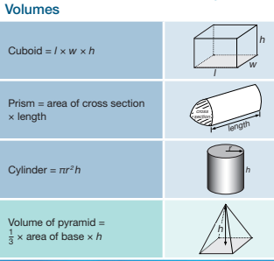
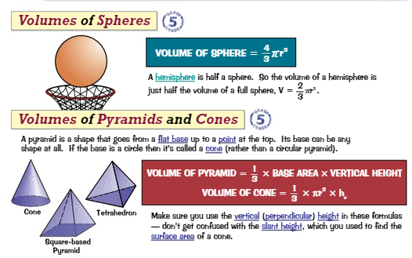
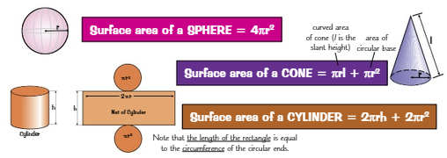
Knowledge Organiser: Mathematics
Year 9 Higher Summer Term 2
Suggested websites: Maths Genie, Save My Exam and Corbett Maths
Key Vocabulary
Coordinates, Angle, Mirror lines, Scaling, Turning, Reflection, Rotation, Enlargement, Translation, Centre of Enlargement, Arcs, Compass, Protractor, Bisector
Big idea: Geometry
Key skills:
Investigate 3D solids
Perform and describe transformations: Rotation, Reflection, Translation, Enlargement
Perform and describe combined transformations
Use Bearings
Constructions
MUST KNOW FORMULAS

Slide 2
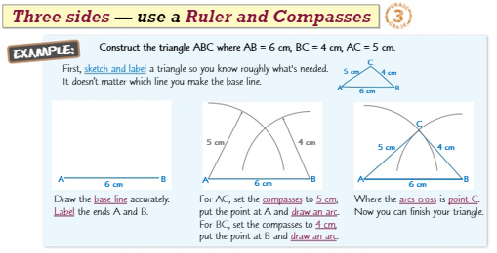
Knowledge Organiser: Mathematics
Year 9 Higher Summer Term 2
Suggested websites: Maths Genie, Save My Exam and Corbett Maths
Key Vocabulary
Coordinates, Angle, Mirror lines, Scaling, Turning, Reflection, Rotation, Enlargement, Translation, Centre of Enlargement, Arcs, Compass, Protractor, Bisector
Big idea: Geometry
Key skills:
Investigate 3D solids
Perform and describe transformations: Rotation, Reflection, Translation, Enlargement
Perform and describe combined transformations
Use Bearings
Constructions

