Slide 1
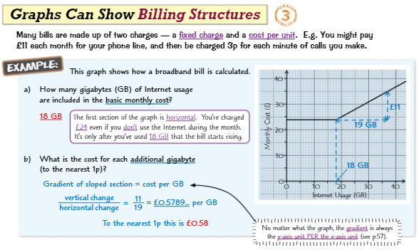
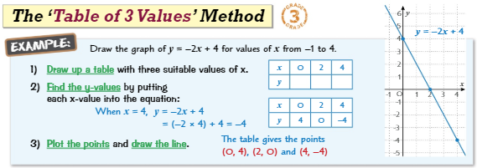
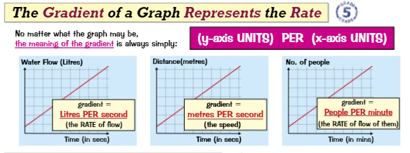
Knowledge Organiser: Mathematics
Year 9 Higher Summer Term 1
Suggested websites: Maths Genie, Save My Exam and Corbett Maths
Key Vocabulary
Coordinates, Ratio, Currency, Conversion, Direct & Inverse Proportion, Indices, Reciprocal, Axes, Table of Values
Big idea: ALGEBRA
Key skills:
Use Straight line graphs
Quadratic graphs
Reciprocal graphs
Real life graphs

Slide 2
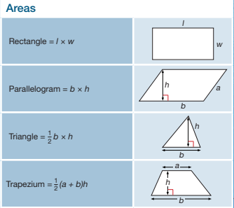
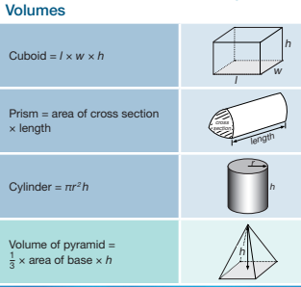
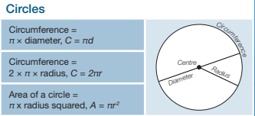
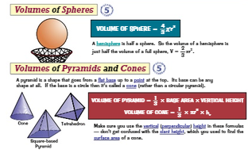
Knowledge Organiser: Mathematics
Year 9 Higher Summer Term 1
Suggested websites: Maths Genie, Save My Exam and Corbett Maths
MUST KNOW FORMULAS
Big idea: GEOMETRY
Key skills:
Calculate areas of 2D shapes
Calculate surface area of 3D shapes
Calculate volume of 3D shapes – including pyramids
Key Vocabulary
Perpendicular, Height, Length, Circumference, Diameter, Radius, Segment, Sector

