Slide 1

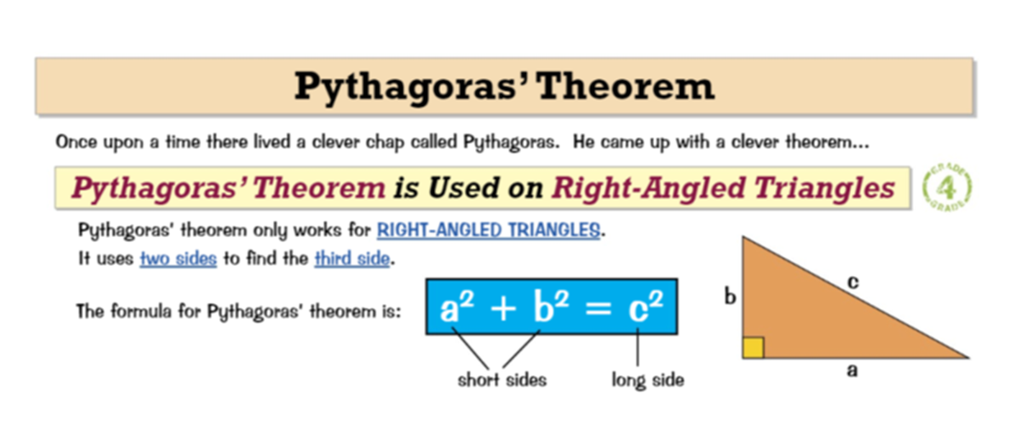
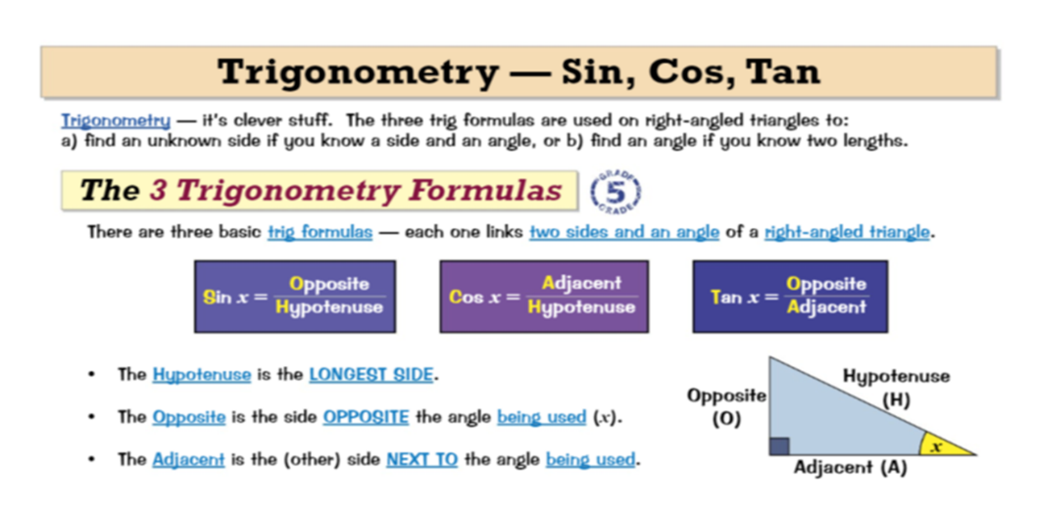
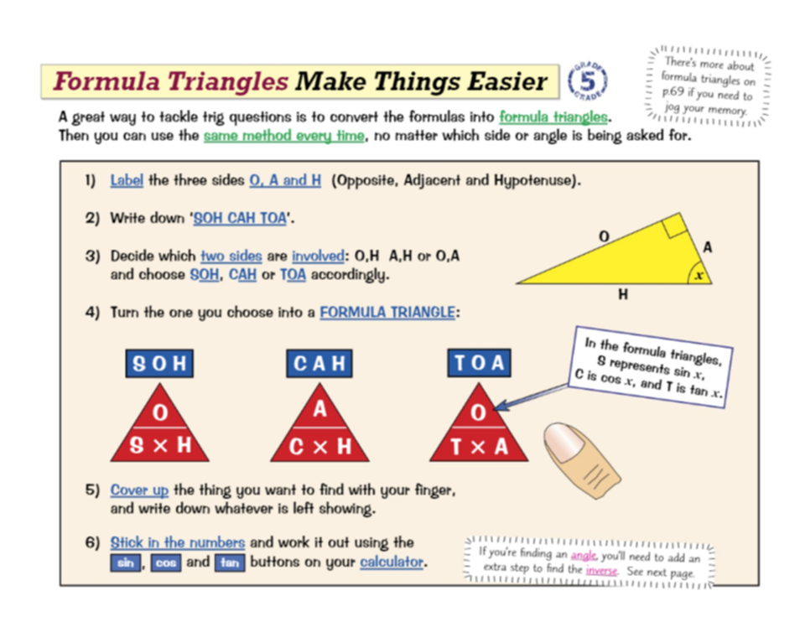
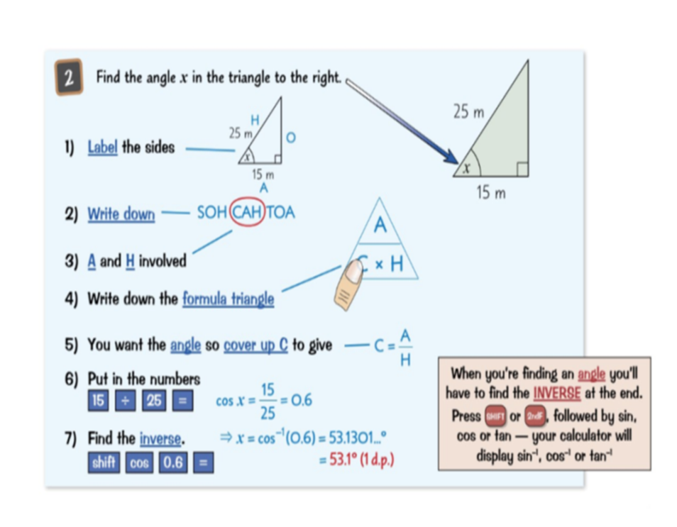
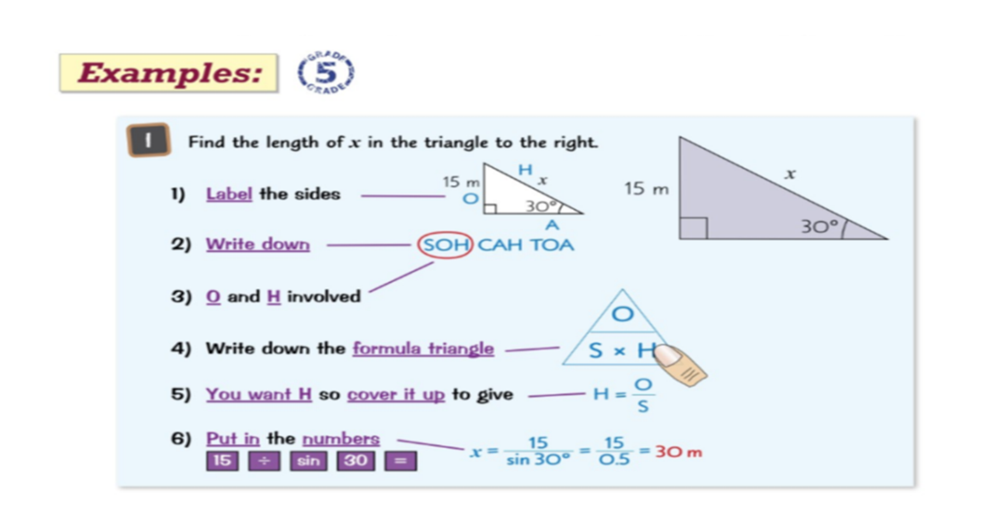
Knowledge Organiser: Mathematics
Year 10 Foundation Spring Term 1
Suggested websites: Maths Genie, Save My Exam and Corbett Maths
Big idea: Geometry and Measure
Key skills:
Use Pythagoras Theorem to solve problems
Use Trig ratios to find unknown sides and angles in a right angle triangle
Key Vocabulary
Adjacent, Sin, Cos, Tan
Opposite
Hypotenuse
Square numbers

Slide 2
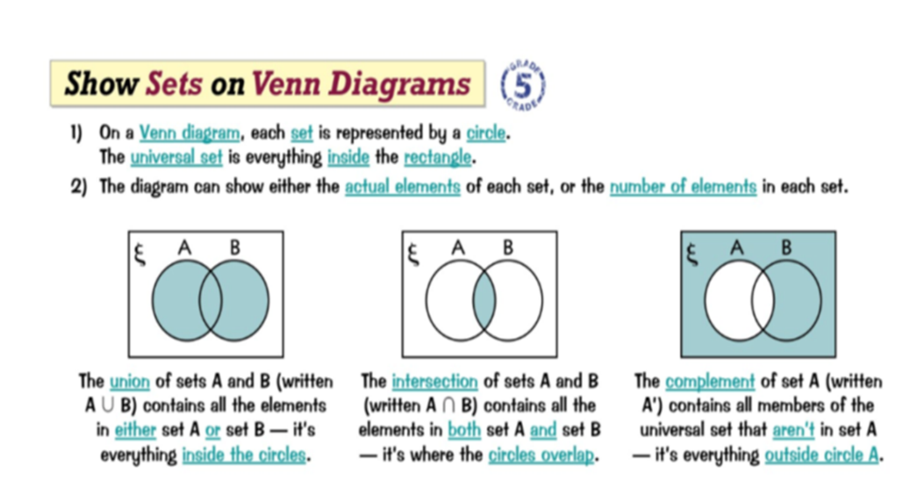
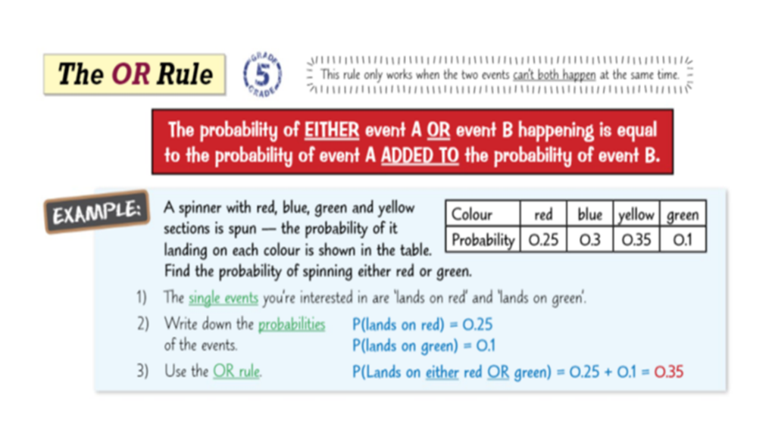
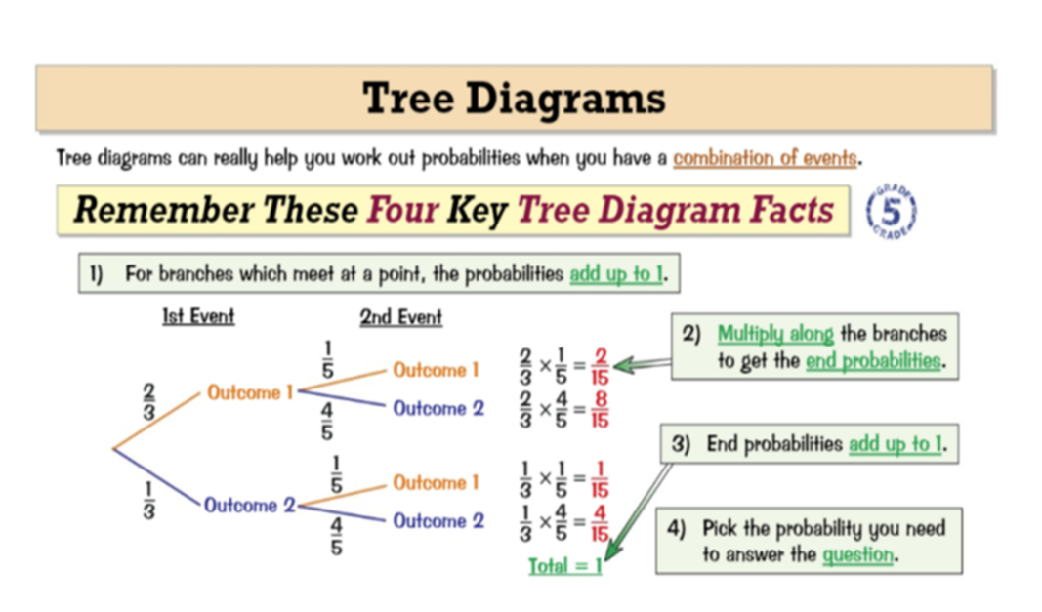
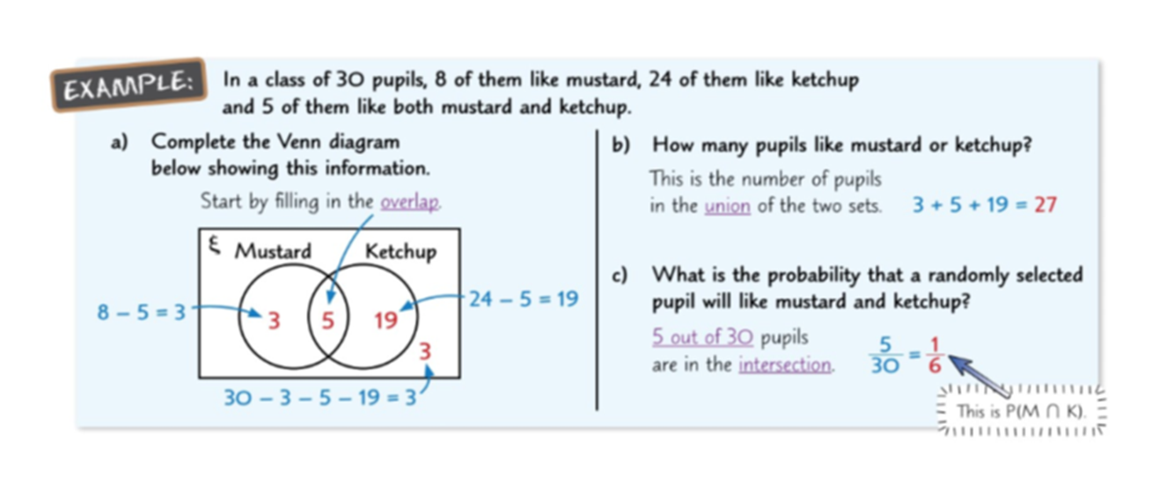
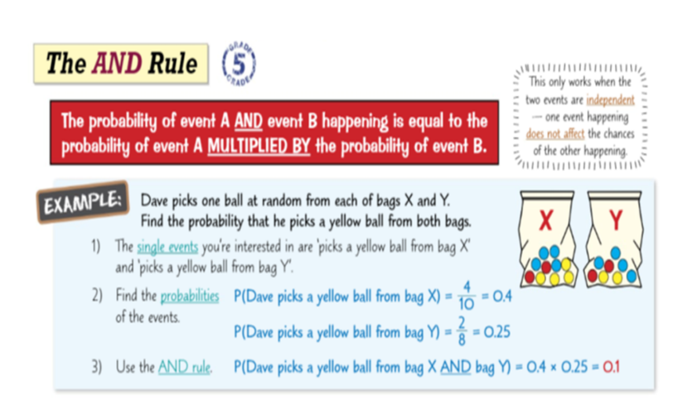
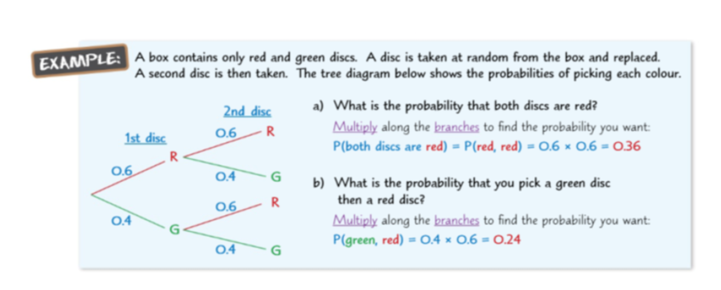
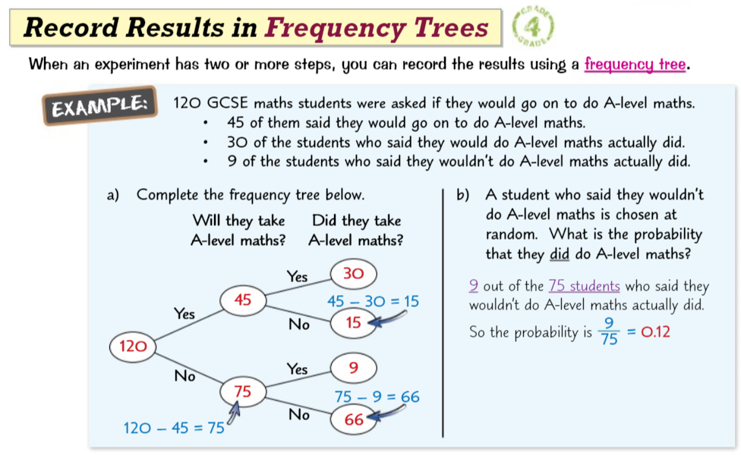
Knowledge Organiser: Mathematics
Year 10 Foundation Spring Term 1
Suggested websites: Maths Genie, Save My Exam and Corbett Maths
Big idea: Probability and Statistics
Key skills:
Calculating probabilities
Draw and interpret Venn Diagrams
Draw and interpret Tree Diagrams
Record results in a frequency tree
Problem Solving
Key Vocabulary
Outcomes
Intersection
Union
Events
Complement
Proportion

