Slide 1
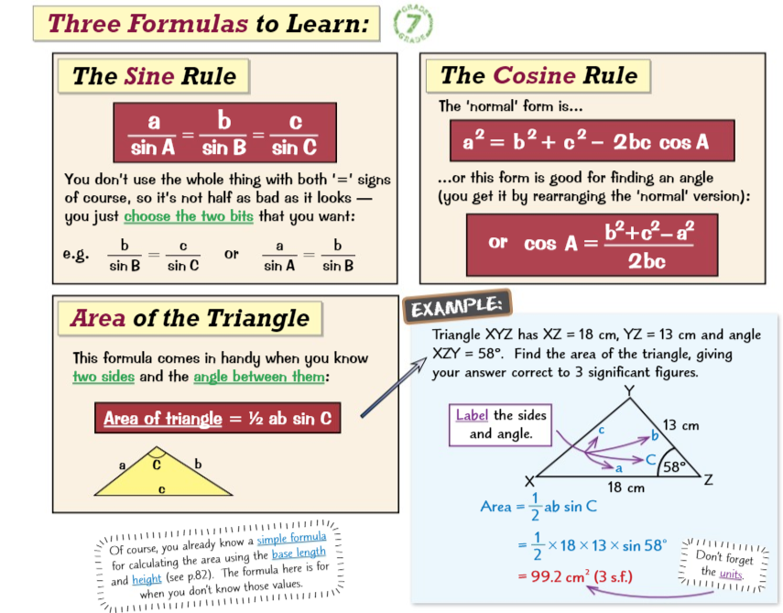
Knowledge Organiser: Mathematics
Year 10 Higher Spring Term 1
Suggested websites: Maths Genie, Save My Exam and Corbett Maths
Big idea: Geometry and Measures
Key skills:
Prove that two triangles are Similar
Prove that two triangles are Congruent
Use similarity to find missing length
Draw the graph of Sine, Cosine and Tangent
Use the Sine and Cosine Rule to find missing angles and sides in non right angle triangles
Key Vocabulary
Similar, Congruent
Hypotenuse, Proportional
Adjacent, Enlargement
Scale Factor, Ratio

